Slide 1
6th Cycle 2023-2031 Housing Element Adoption Hearing
CITY OF CARMEL-BY-THE-SEA
April 8, 2024
City Council Special Meeting

Slide 2
Goals
Accommodate our allocation of housing units while preserving the character of the village
Avoid increasing building height in the commercial district
Avoid rezoning/densification in the residential district
Maintain local control of development processes
Protect the village against lawsuits and Builder’s Remedy
Achieve a certified housing element by the mandatory deadline of December 15, 2023 (preferred)
Achieve a certified housing element by April 15, 2024 (end of grace period)

Slide 3
Consequences
Portola Valley housing element certification has been revoked
Beverly Hills lost their ability to issue permits
Fullerton referred to the Attorney General for failing to adopt a Housing Element
La Cañada Flintridge referred to the Attorney General for failing to adopt a compliant housing element and denying a subsequent builder’s remedy project
Santa Monica failed to adopt a housing element and received 16 builder’s remedy applications including a 15-story, 2,000 unit project near a rail station
Other penalties could include fines and loss of grant funding
https://www.hcd.ca.gov/planning-and-community-development/accountability-and-enforcement
Notes:
Mission Trail Nature Preserve, State storm recovery funds, Preparing for sea level rise/repair seawall, CALFire grant for Forest Management Plan, Storm drains; sewer

Slide 4
Housing Opportunities
3 City-owned Sites: 149 affordable units
Sunset Center South Lot (60 units)
Sunset Center North Lot (33 units)
Vista Lobos (56 units)
22 Privately-owned Sites: 28 affordable, 111 market rate = 139 units
Hospitality Employee Housing: 31 affordable units
Accessory Dwelling Units (ADUs): 30 affordable, 4 market rate = 34 units
Pipeline Projects: 21 affordable (ADUs), 36 market rate = 57 units (and growing!)
Accessory Dwelling Units, apartments, single family homes
Total: 410 units (17% buffer)
CARMEL-BY-THE-SEA
231 affordable
118 market-rate
349 total
Notes:
The privately owned sites with affordable units: 5 moderate on Bruno’s; 10 low and 11 very low on Carmel Foundation; 2 low on Forest Cottages.
Pipeline projects include Ulrika Plaza (5th & Dolores), the proposed JB Pastor building (7th & Dolores), single family homes at Carmel Resort Inn, and three apartments on Dolores in the Percy Parkes building.
No projects are being approved tonight.

Slide 5
Recommendation
Staff recommends that the City Council:
Adopt a Resolution 2024-028 adopting a Mitigated Negative Declaration and associated Mitigation Monitoring and Reporting Program for the 2023-2031 Housing Element of the General Plan; and
Adopt Resolution 2024-029 approving a General Plan Amendment repealing the 2015-2023 Housing Element and adopting the 2023-2031 Housing Element of the General Plan in compliance with State housing element law.

Slide 6
What’s Next?
Submit an adopted Housing Element to HCD for formal certification.
Housing Element Implementation
*Maintain local control by providing new housing opportunities
*Thoughtfully direct growth to protect Carmel’s character
Complete Safety Element update (pending updated State and Local Responsibility Area Fire maps).

Slide 7
The End

Slide 8
Program 1.1.B, City-owned sites
Step One:
Adopt development standards for the north and south parking lots. This is a zoning code amendment and requires approval from the Planning Commission, City Council, and Coastal Commission.
Step Two:
Develop a project description (what is the community’s vision for the project), establish an RFP process (with community and Council input), and solicit proposals from qualified affordable housing developers. Review proposals (with community and Council input).
Step Three:
Select a developer and enter into an exclusive negotiating agreement.
Step Four:
Review a development proposal and seek approval from the Planning Commission.
Step Five:
If water resources are available, proceed with construction. If not, the project will be in a holding pattern until water becomes available.

Slide 9
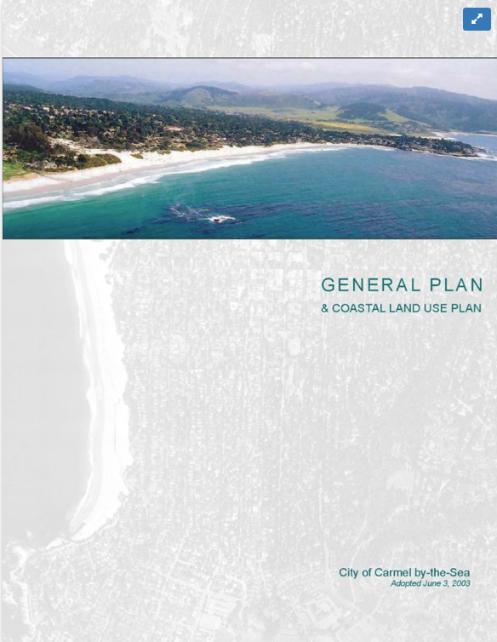
General Plan Update
The Housing Element is part of the General Plan, adopted in 1983 and updated in 1988 and 2003.
Introduction
Land Use* and Community Character
Circulation*
Housing*
Coastal Access and Recreation
Coastal Resource Management
Public Facilities and Services
Open Space* and Conservation*
Environmental Safety*
Noise*
*State mandated elements (7)
Local Coastal Program elements in italic
https://ci.carmel.ca.us/post/general-plan

Slide 10
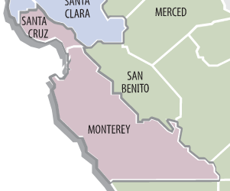
Response to Housing Crisis
2.5 million homes needed statewide.
Monterey County is located within the Association of Bay Area Governments (AMBAG) region.
The State allocated 33,274 housing units to the AMBAG region which includes two counties (Santa Cruz and Monterey) and 16 cities.
Carmel-by-the-Sea has been allocated 349 housing units.

Slide 11
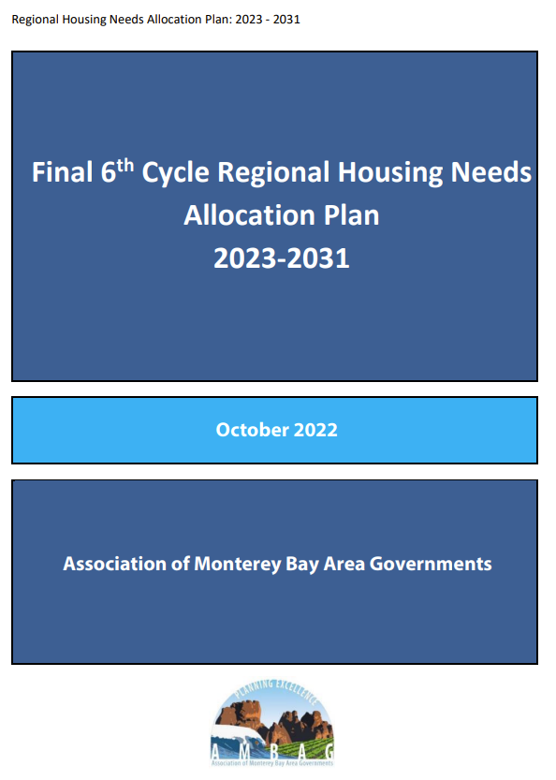
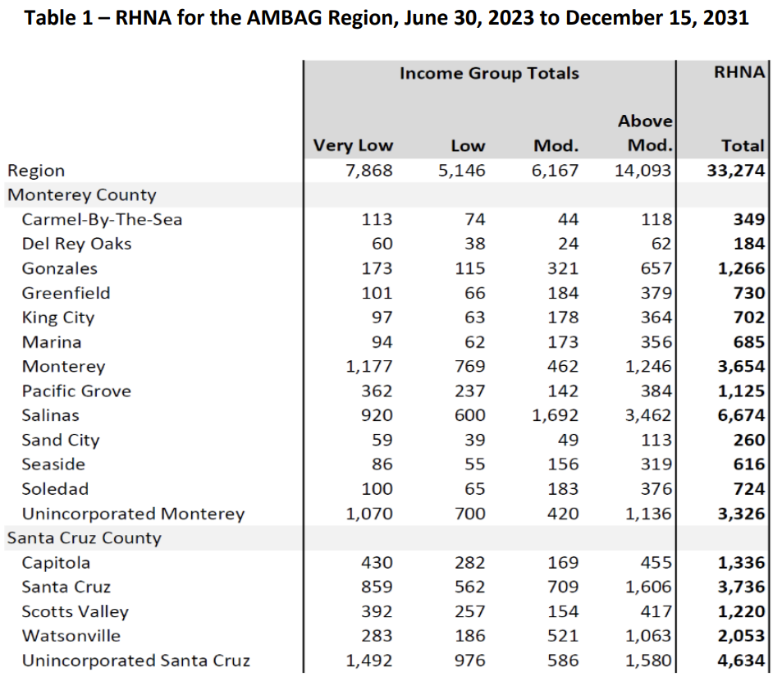
6th cycle Housing Element Update
ADOPTED
Notes:
RHNA plan adopted by the AMBAG Board of Directors on October 12, 2022.
CARMEL-BY-THE-SEA: 349 units of which 231 are affordable and 118 market rate.

Slide 12
Housing Ad Hoc Committee
Mayor Pro Tem Bobby Richards and Councilmember Karen Ferlito
“The mission of the Housing Ad-Hoc Committee is to provide guidance as the City updates the Housing Element of its General Plan. The Committee will participate in public outreach and education; consider opportunities and incentives for development of affordable housing; and explore creative, tailored solutions to meet the City’s workforce and range of housing needs while preserving the character of Carmel by-the-Sea”
brichards@cbts.us
kferlito@cbts.us
Notes:
Appointed by the Mayor in September 2022

Slide 13
Goals
Accommodate our allocation of housing units while preserving the character of the village
Avoid increasing building height in the commercial district
Avoid rezoning/densification in the residential district
Maintain local control of development processes
Protect the village against lawsuits and Builder’s Remedy
Achieve a certified housing element by the mandatory deadline of December 15, 2023 (preferred)
Achieve a certified housing element by April 15, 2024 (end of grace period)

Slide 14
Consequences
Portola Valley housing element certification has been revoked
Beverly Hills lost their ability to issue permits
Fullerton referred to the Attorney General for failing to adopt a Housing Element
La Cañada Flintridge referred to the Attorney General for failing to adopt a compliant housing element and denying a subsequent builder’s remedy project
Santa Monica failed to adopt a housing element and received 16 builder’s remedy applications including a 15-story, 2,000 unit project near a rail station
Other penalties could include fines and loss of grant funding
https://www.hcd.ca.gov/planning-and-community-development/accountability-and-enforcement
Notes:
Mission Trail Nature Preserve, State storm recovery funds, Preparing for sea level rise/repair seawall, CALFire grant for Forest Management Plan, Storm drains; sewer

Slide 15
Community Engagement: Meetings
January 4, 2022 City Council Meeting - RHNA and Senate Bills Presentation
November 17, 2022 Community Meeting - Project Kick off
February 7, 2023 City Council Meeting - ECONorthwest Feasibility Study
February 28, 2023 Community Meeting - Development constraints/incentives
April 6, 2023 Community Meeting - 5th cycle Housing Element overview
May 24, 2023 Community Meeting - Housing needs, Housing sites, Policies/Programs
June 15, 2023 Joint Planning Commission/City Council Meeting - Review Draft
July 11, 2023 City Council Meeting - Revisions to draft
August 1, 2023 City Council Meeting - Final draft, authorization to submit to HCD
November 13, 2023 City Council Meeting - Review HCD 90-day findings letter
January 9, 2024 City Council Meeting - Update on revisions
March 5, 2024 City Council Meeting - Update on revisions
April 2, 2024 City Council Meeting - Update on revisions
April 8, 2024 City Council Meeting - Adoption hearings (14th Meeting)
Notes:
13 meetings.
Direction to staff early on in the process:
No increase in building height in the commercial district, and No rezoning/densification of the residential district

Slide 16
Community Engagement: Communication
Dedicated project website
H.O.M.E (Housing Opportunities Made Easier)
https://homecarmelbythesea.com/
Official City website
https://ci.carmel.ca.us/post/long-range-planning-initiatives
https://ci.carmel.ca.us/meetings
City Council, Planning Commission, & Housing listservs
Tribal outreach
Weekly Friday Letter / VLOG
City YouTube channel
https://www.youtube.com/@CityofCarmelbytheSea
Reader’s Guides
Carmel Pine Cone
Carmel Farmers Market Booth
Carmel Chamber of Commerce Survey
Door-to-Door Downtown Survey
Letters mailed to property owners of potential housing sites

Slide 17
Community Engagement: Survey/Farmer’s Market
Notes:
160 survey responses

Slide 18
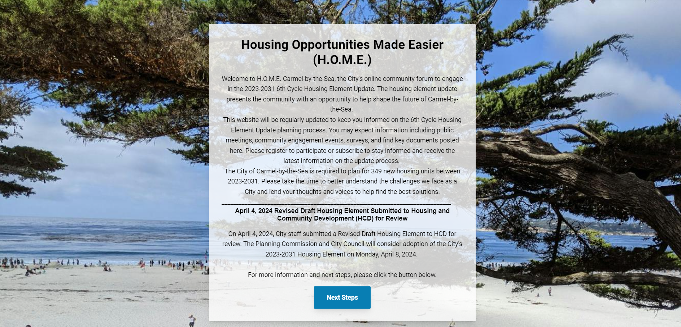
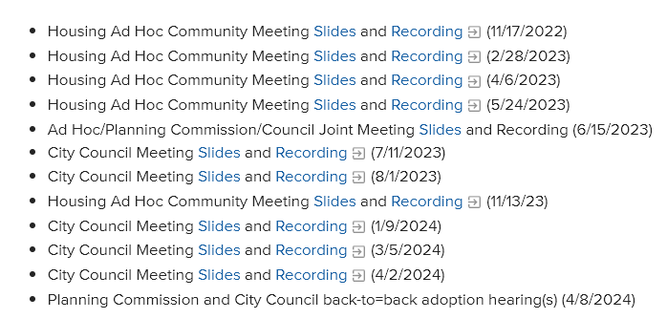
Community Resources Online
https://homecarmelbythesea.com/
https://ci.carmel.ca.us/post/long-range-planning-initiatives

Slide 19
Collaboration with HCD
August 3, 2023: Submitted 1st draft of the 6th cycle housing element to HCD
September 15, 2023: Received mid-review comments from HCD
October 2, 2023: Submitted revised draft
November 1, 2023: Received formal 90-day review findings letter from HCD
January 24, 2024: Submitted revised draft
February 6, 2024: Received mid-review comments from HCD
March 5, 2024: City Council Meeting to review response to HCD Comments
March 6-8, 2024: Final edits completed with Council Ad Hoc Committee
March 8, 2024: Submitted revised draft to HCD
March 20, 2024: Received foram 60-day review findings letter from HCD

Slide 20
Collaboration with HCD (cont.)
March 20-27, 2024: Revisions completed with the Housing Ad Hoc Committee
March 27, 2024: Revised draft posted for 7-day public comment period
April 2, 2024: Public comment period closed following the City Council meeting
April 3-4, 2024: Revisions incorporated with Housing Ad Hoc Committee
April 4, 2024: Final draft and all public comments posted on line and submitted to HCD
April 5, 2024: Received letter of substantial compliance from HCD
April 8, 2024: Adoption hearings with the Planning Commission and City Council
April 9, 2024: Submit adopted Housing Element to HCD
April 10-15, 2024: Receive formal certification of Housing Element from HCD
April 16, 2024-Dec 31, 2031: Implement the housing plan

Slide 21
Organization of Housing Element
Chapter 1: Introduction
Chapter 2: Goals, Policies, and Programs
Appendix A: Housing Needs and Fair Housing Report
Appendix B: Housing Constraints
Appendix C: Vacant and Available Sites
Appendix D: Review of the Previous Housing Element
Appendix E: List of Contacted Organizations
Appendix F: ECONorthwest Feasibility Study
Appendix G: Energy and Resource Conservation
Appendix H: Stakeholder Survey

Slide 22
Housing Opportunities
3 City-owned Sites: 149 affordable units
Sunset Center South Lot (60 units)
Sunset Center North Lot (33 units)
Vista Lobos (56 units)
22 Privately-owned Sites: 28 affordable, 111 market rate = 139 units
Hospitality Employee Housing: 31 affordable units
Accessory Dwelling Units (ADUs): 30 affordable, 4 market rate = 34 units
Pipeline Projects: 21 affordable (ADUs), 36 market rate = 57 units (and growing!)
Accessory Dwelling Units, apartments, single family homes
Total: 410 units (17% buffer)
CARMEL-BY-THE-SEA
231 affordable
118 market-rate
349 total
Notes:
The privately owned sites with affordable units: 5 moderate on Bruno’s; 10 low and 11 very low on Carmel Foundation; 2 low on Forest Cottages.
Pipeline projects include Ulrika Plaza (5th & Dolores), the proposed JB Pastor building (7th & Dolores), single family homes at Carmel Resort Inn, and three apartments on Dolores in the Percy Parkes building.

Slide 23
Response to Public Comments
Housing Element is a “living document”
Staff reports annually to HCD on the number of housing units in review, approved, under construction, and completed
City-owned sites:
Refined Surplus Land Act language, ensured consistent language among the three sites
Eliminated builder’s incentive of only one public hearing
Added clarifying language to Table C-3, Sites Inventory that sites are not listed in order of priority
Updated project timeline

Slide 24
Environmental Review (CEQA)
The City of Carmel-by-the-Sea has undertaken environmental review for the proposed 6th Cycle 2023-2031 Housing Element Update.
The City filed a Notice of Intent (NOI) to adopt a Mitigated Negative Declaration with the Monterey County Clerk on 2.22.2024 and posted online for a 30-day public review period; subsequent revisions of the Housing Element did not impact the environmental review.
Two comment letters received.
No substantive changes to the environmental document.

Slide 25
Project Team
Carmel-by-the-Sea
Mayor Pro Tem Bobby Richards
Councilmember Karen Ferlito
Chip Rerig, City Administrator
Brandon Swanson, CPB Director/Assistant City Administrator
Marnie R. Waffle, Principal Planner
Katherine Wallace, Associate Planner
With support from the entire CPB staff!
Consultant: EMC Planning Group
Michael Groves
Anastazia Aziz
Ande Flower
Kylie Pope
Kailon Thompson
Stuart Poulter
Martin Carver
Teri Wissler Adam
Shoshana Lutz
Tiffany Robinson

Slide 26
Recommendation
Staff recommends that the Planning Commission:
Adopt a Resolution (Attachment 1) recommending the City Council adopt a Mitigated Negative Declaration and associated Mitigation Monitoring and Reporting Program for the 2023-2031 Housing Element of the General Plan.
Adopt a Resolution (Attachment 2) recommending the City Council approve a General Plan Amendment repealing the 2015-2023 Housing Element and adopting the 2023-2031 Housing Element of the General Plan in compliance with State housing element law.

Slide 27
What’s Next?
Submit an adopted Housing Element to HCD for formal certification.
Housing Element Implementation
*Maintain local control by providing new housing opportunities
*Thoughtfully direct growth to protect Carmel’s character
Complete Safety Element update (pending updated State and Local Responsibility Area Fire maps).

Slide 28
Grant Funding
$160,000: Senate Bill 2 (SB2)
$ 65,000: Local Early Action Planning (LEAP)
$ 65,000: Regional Early Action Planning (REAP1)
$290,000: Total Grant Funding
$371,931: EMC Contract Total
$ 81,931: Difference
$ 42,500: REAP2 (pending)

