Slide 1
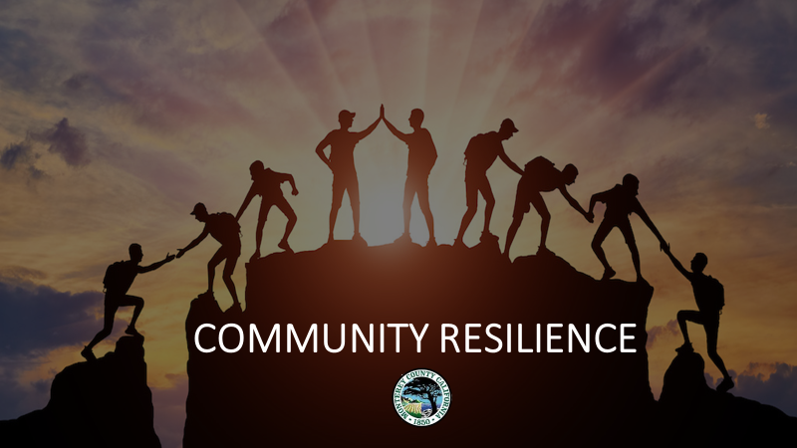
PLAN DRAFT:
Word Version: https://docs.google.com/document/d/1TrgPymXxPXST-kI8Yju7dFq-4YsPBOre/
PDF Version: https://drive.google.com/file/d/1dFobMx6UPJqY6x6SxIMNYXJ1iifLMQAz/

Slide 2
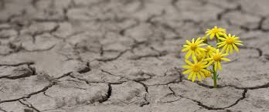
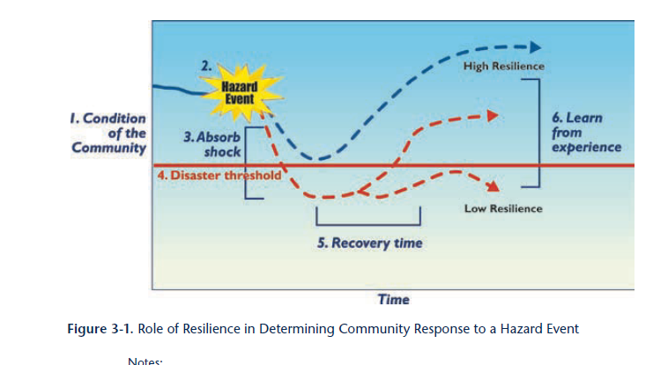
WHAT IS COMMUNITY RESILIENCE
Resilience is the ability to prepare for, cope with, overcome, positively adapt to and recover from change, including adverse or stressful events.
When disasters strike, resilient communities are better able to recover from the incident; to learn from the experience; and to become stronger and better prepared as a result.

Slide 3
Community Resilience Project Goals
Unite: Promote cross-sector cooperation and collaboration on resilience building efforts.
Empower: Support existing community resilience projects and encourage development of new ones.
Understand our community: by leveraging the knowledge of the whole community and making findings accessible and digestible for all.
Engage: Increase the engagement of individual community members and organizations in resilience building activities.

Slide 4
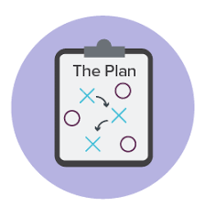
Purpose of the Community Resilience Plan
This plan provides an analysis of Monterey County’s
Capabilities and Strengths, including best practices and successful projects
Risks and Needs, including lessons learned from past and current disasters and projects
Current & Planned Resilience Projects
In order to:
Inform current and future resilience building projects, including providing a county developed document that shows current needs and can be used as a supporting document for future grant applications
Provide an expanded lens for viewing disaster resilience that engages and includes the whole community and all sectors within it
Compliment current emergency plans, including the County’s Multijurisdictional Hazard Mitigation Plan

Slide 5
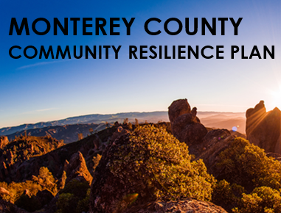
The Monterey County Community Resilience Plan provides an analysis on community resilience in Monterey County, highlighting community strengths that make us more disaster resilient and community challenges, that work as barriers to resilience. The plan also includes recommendations and strategies for becoming more resilient as a community, including list current and planned initiatives and actions that foster community resilience
1. CHALLENGES
Rapidly changing environment
Failing infrastructure
Unsustainable lifestyle
Social inequity and vulnerability
Unaffordability
Housing conditions
Overstressed food, water, & supply chain
2. STRENGTHS
Community connections
Schools as a community resource
Culture of preparedness
Collaboration during disasters
3. STRATEGIES
Build Social Capital
Enhance Emergency Services Infrastructure
Move Toward Sustainability
Create Healthy Communities
Encourage Resilience Households
Empower Social Mobility

Slide 6
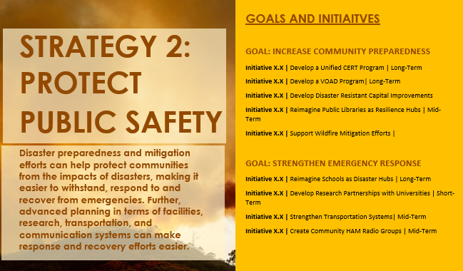
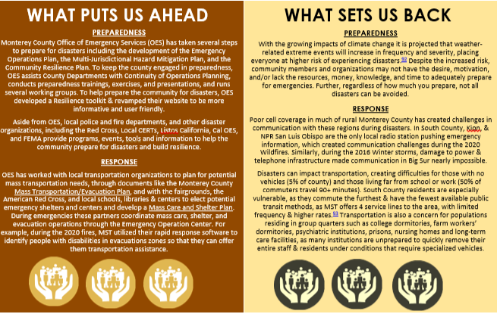
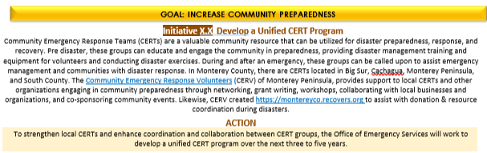
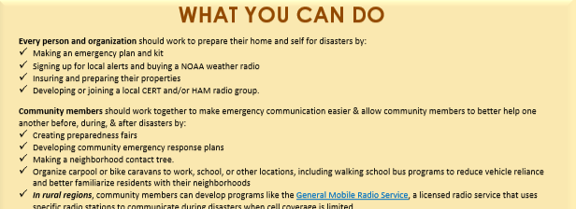
Strategy Chapter
ALL 6 STRATEGY CHAPTERS FOLLOW THE SAME FORMATTING:
A brief intro to the strategy, with goals & initiatives listed
A What Puts Us Ahead and What Sets Us Back section that reviews progress and hurdles we face for meeting the goals
A few sentences providing background on each initiative and subsequent actions
Clear action items with a timeline and group(s) responsible
A What You Can Do section that provides recommendations for the community to help meet the listed goals.

Slide 7
Pages 58-67

Slide 8
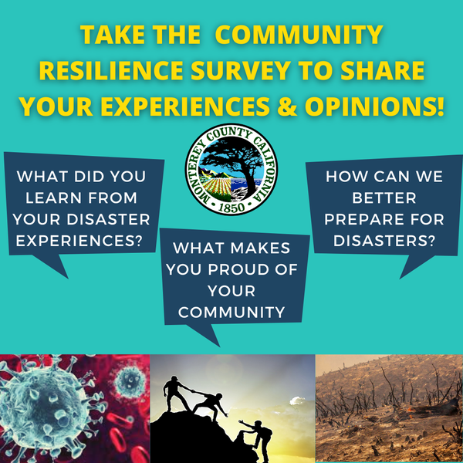
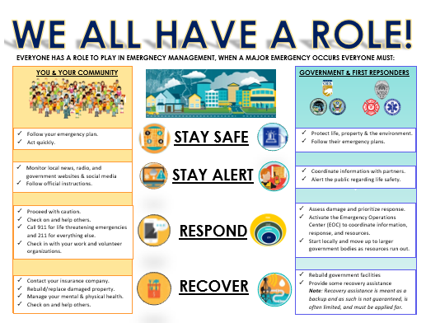
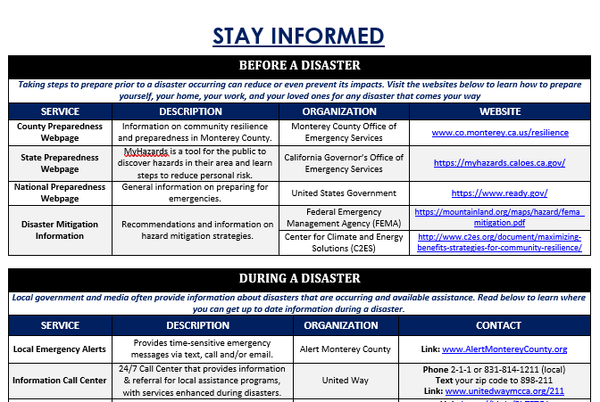
Plan Attachments (all provided in English & Spanish)
Community Resilience Survey – These surveys provide local organizations and residents an opportunity to provide their opinions and feedback on community resilience in Monterey County. The results will be incorporated into the plan and used to inform future projects. Please take and help push out the survey through your social media and website!
Outreach Packets – Working on Response and Recovery Packets with goal of publishing with plan before the end of the year. View the 2 current preparedness packets a: www.co.monterey.ca.us/government/departments-a-h/administrative-office/office-of-emergency-services/ready-monterey-county
Disaster Resource Directory – completed all edits; working on translation. Will publish by the end of September at www.co.monterey.ca.us/resilience
Organizations: https://arcg.is/08bGHG Individuals: https://arcg.is/04vPv

Slide 9
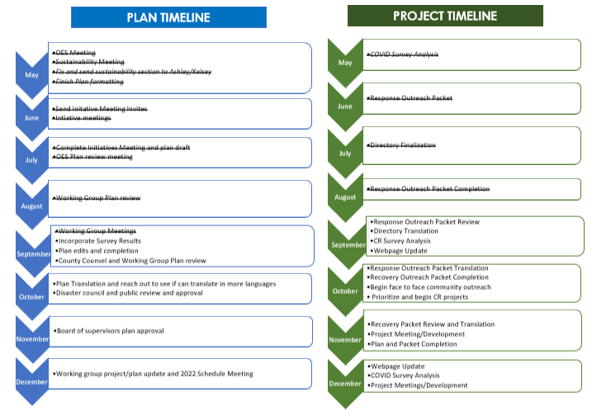
Community Resilience Project Timeline

Slide 10
What we are looking for from you
Formatting suggestions to make the plan more user friendly
Review of language and grammar
Additions, removals, and changes of challenges, strengths, strategies, and initiatives
Any initiatives, recommendations or highlights you would like included for your organization
Working Group Review Period ends September 22, 2021
Public Review Period ends
October 27, 2021

Slide 11
How to provide feedback
Send an edited word document back to me (with track changes on or changes highlighted/in red)
Email me a list of suggested changes
Give me a call (831-796-1923) or send me a zoom invite
Email MohammadL@co.monterey.ca.us to be added to the distribution list, to provide feedback, or for more information about the Community Resilience Project and Plan

