Slide 1
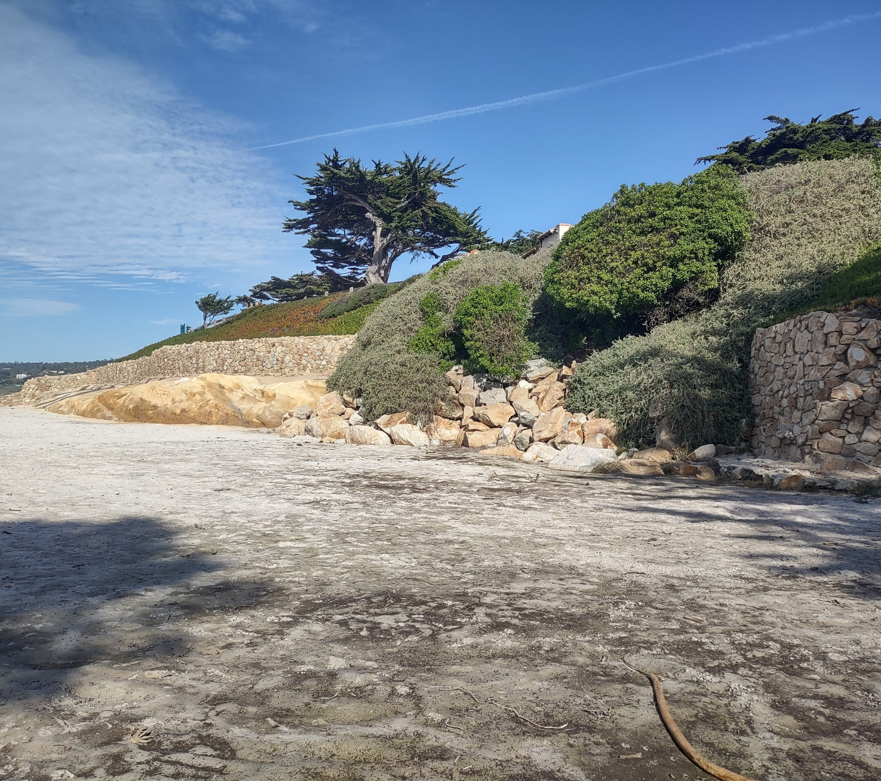
City of Carmel-by-the-Sea
Task 3: Shoreline and Beach Erosion Exposure with Sea Level Rise
Task 4: Coastal Hazard and Sea Level Rise Vulnerability Assessment
David Revell, PhD
Matt Jamieson, MFA
Ashley Ellenson, PhD
February 15, 2024
Climate Committee

Slide 2
Presentation Outline
Sea Level Rise and Processes Driving Erosion
Methods
Results
  Beach narrowing
  Cliff and dune retreat
  Wave overtopping
Vulnerability Assessment
  Summer dry sand beach and recreation space
  Land use and structures
  Roads and parking
  Utilities and infrastructure

Slide 3
Task 3 and 4 Scope of Work
To project beach, cliff, and dune erosion hazards with sea level rise
Summarize the risk to public and private infrastructure and assets
Determine the likelihood of impact across multiple sea level rise horizons and erosion scenarios.
Erosion scenarios included:
  Erosion rate baselines: likely (0.2 ft/yr), best estimate (0.4 ft/yr), worst case (0.7 ft/yr) to provide a range of erosion projections
  With and Without coastal armoring

Slide 4
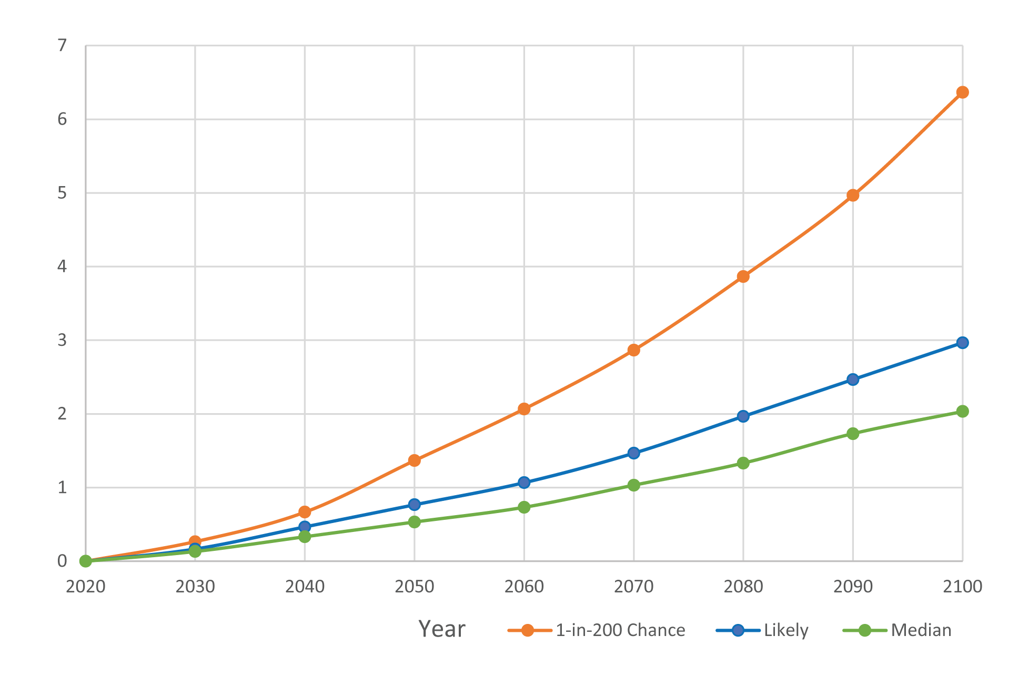
Sea Level Rise Scenarios
Sea level rise projections are based on the State of California Sea Level Rise Guidance from 2018 and the 2024 draft update.
Sea level rise scenarios considered medium-high risk aversion (.5% likely) to low-risk aversion (66% likely):
  Current conditions, 2020 baseline (what is at risk now)
  Near-term, 1 ft of SLR / 2045 - 2060
  Medium-term, 2 ft of SLR / 2060 – 2080
  Long-term, 4 ft of SLR / 2080 – 2100+

Slide 5
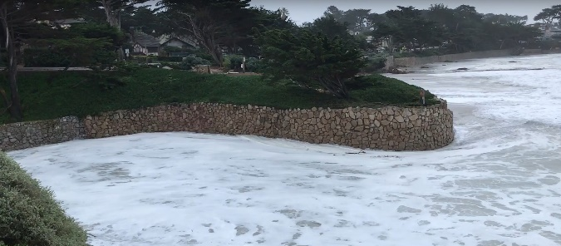

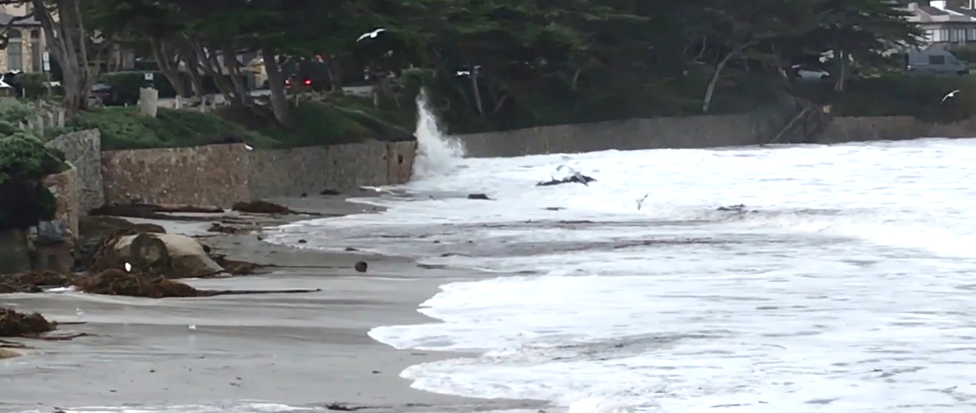
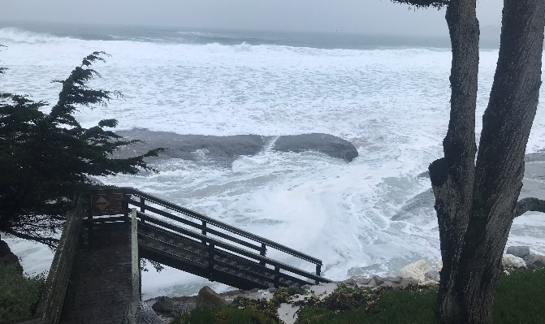

Processes Driving Erosion
Coastal Processes:
Tide level
Breaking wave run up
Wave reflection
Wave overtopping
Local Conditions:
Geomorphology
Coastal armoring
Cliff/bluff substrate
Localized currents generated by waves
Other: Stormwater runoff, anthropogenic factors…
El Niño years typically have higher water levels and storminess resulting in more erosion

Slide 6
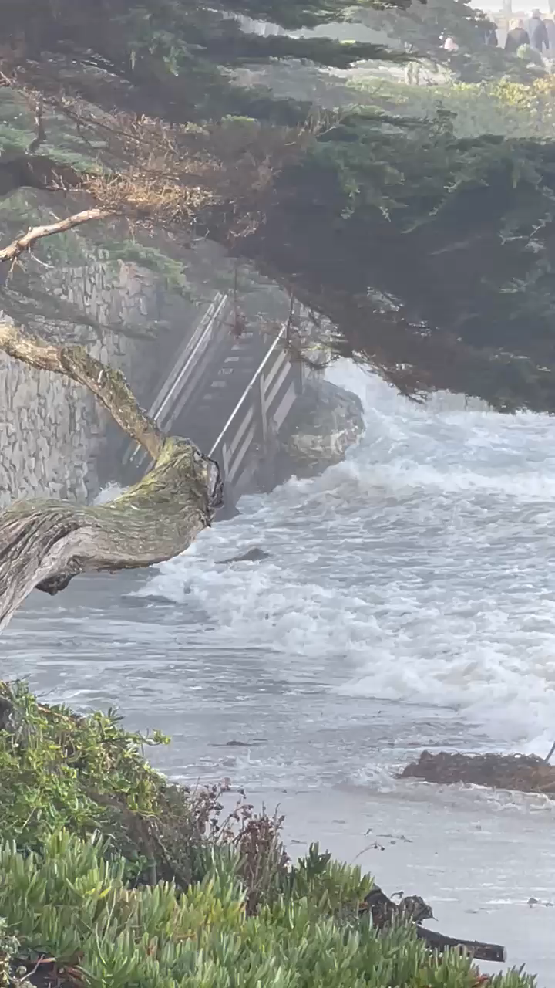
Recent Observations
Winter storms from 2022/23 and 2023/24 have been powerful and destructive
Video: Stairs at Martin Way, January 2024.

Slide 7
Beach Width Narrowing
With Existing Coastal Armoring
Methods and Results

Slide 8
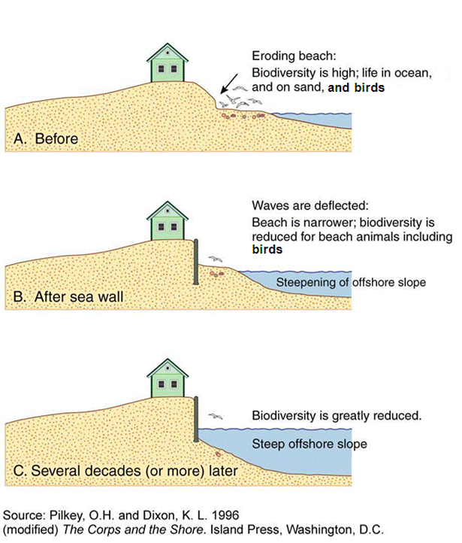
What is Beach Narrowing?
On armored coastlines, beaches will narrow and can become permanently inundated with sea level rise - this is known as Coastal Squeeze or Passive Erosion
Upland development is temporarily saved at the expense of the sandy beach
Over time, recreational beach areas and habitats will be lost unless action is taken

Slide 9
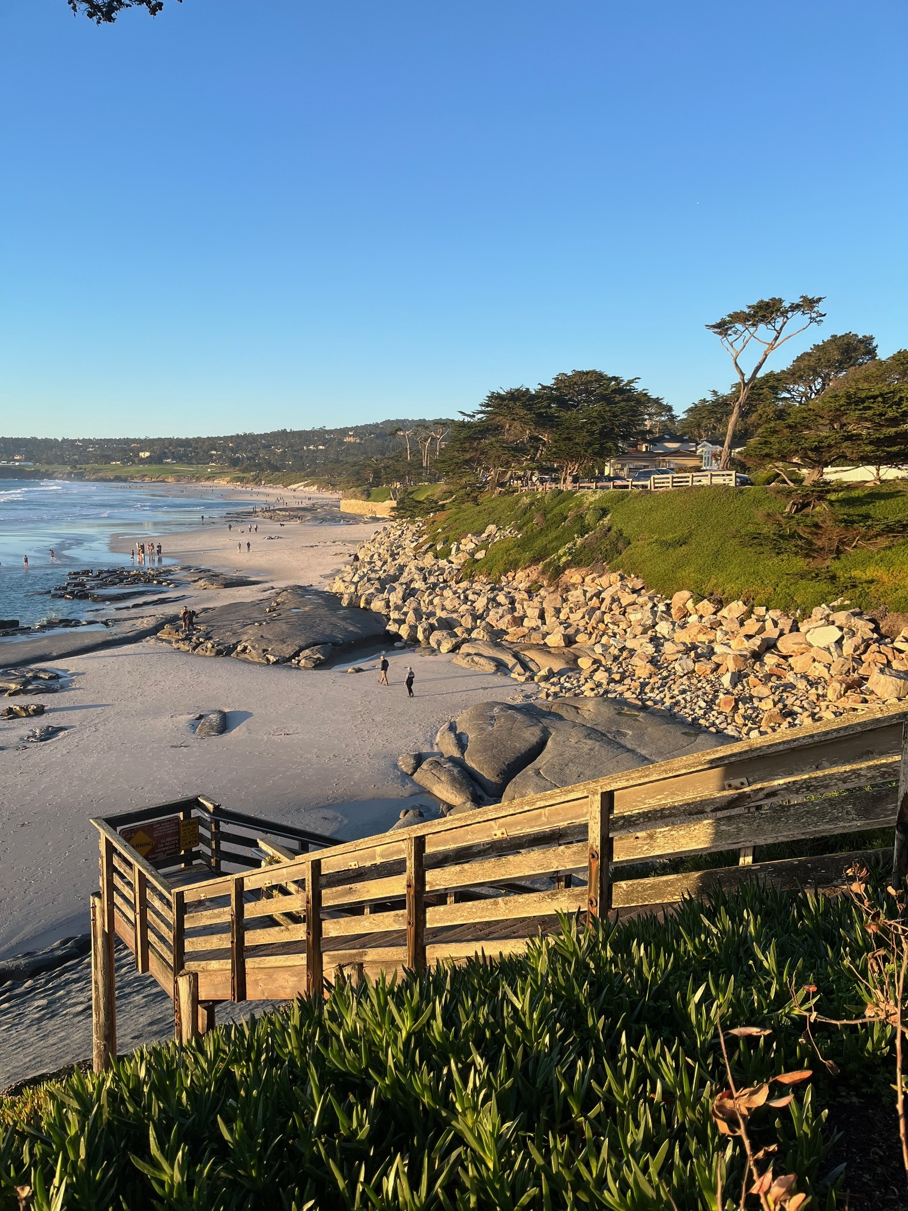
Beach Narrowing Methods
Project typical summer beach widths for each foot of sea level rise
Typical summer beach is based the CoastSat data presented in Task 2 (using 75th percentile from 1984-2021)
Winter beach varies widely and is often scoured completely in the south beach (like now)
This model can be considered a “hold the line” scenario and represents what may occur if no adaptation strategies are implemented in the future

Slide 10
Beach Width Narrowing Findings
Summer beach widths may narrow ~50 - 60 feet for each foot of sea level rise
Beach widths are generally higher in the northern section than the southern section
By 1 ft of sea level rise, typical summer dry sand beach could be reduced by 20%
By 2 ft of sea level rise, reduced by 40%, with loss of lateral beach access to areas south of the 12th Avenue headland
By 4 ft of sea level rise, reduced by 80%, with two small pocket beaches remaining in the south, but dry beach remaining north of the sand ramps
By 5 ft of sea level rise, very little dry sand beach remains

Slide 11
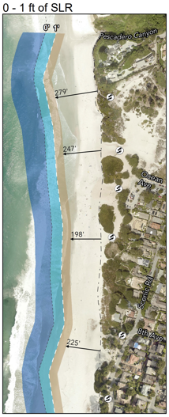
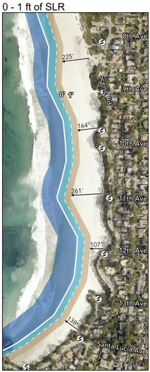
Beach Width Narrowing:
Short term (2045 - 2060)
North
South
A typical summer beach still exists
Southern section becomes “squeezed” especially at 12th avenue headland

Slide 12
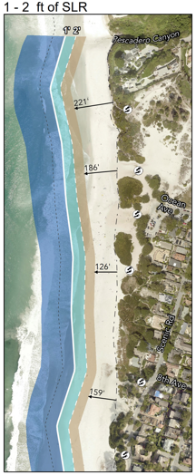
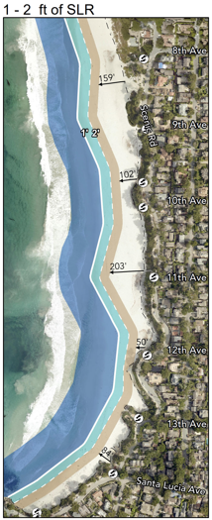
Beach Width Narrowing:
Medium-term (2060 - 2080)
North
South
The northern beach section remains connected laterally
Lateral access to areas south of 12th Avenue headland may be restricted

Slide 13
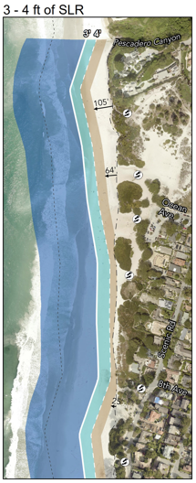
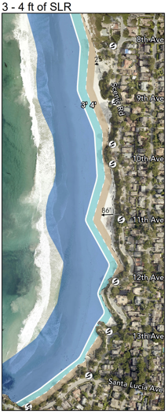
Beach Width Narrowing : Long Term (2080 – 2100)
North
South
Only continuous dry sand beach is between the northern sand ramps to Pescadero Canyon
Two small pockets between 8th avenue and 11th avenue (~1.5 acres each)

Slide 14
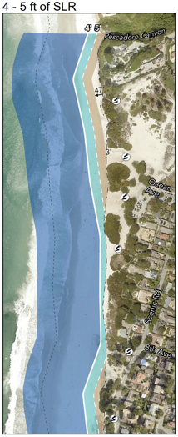
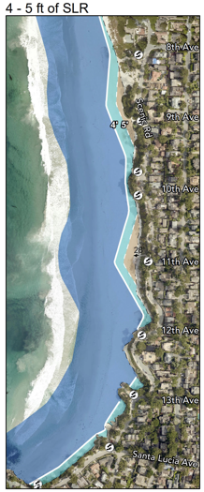
Beach Width Narrowing beyond 2100
North
South
Very little beach remains by 5 ft of SLR
Sea Level Rise Elevation (ft) | Acres of Dry Sand Beach (summer) | Percentage
0 | 34.2 | 100%
1 | 27.4 | 80%
2 | 20.7 | 61%
3 | 14.1 | 41%
4 | 7.6 | 22%
5 | 2.6 | 8%

Slide 15
Cliff & Dune Erosion Methods and Results

Slide 16
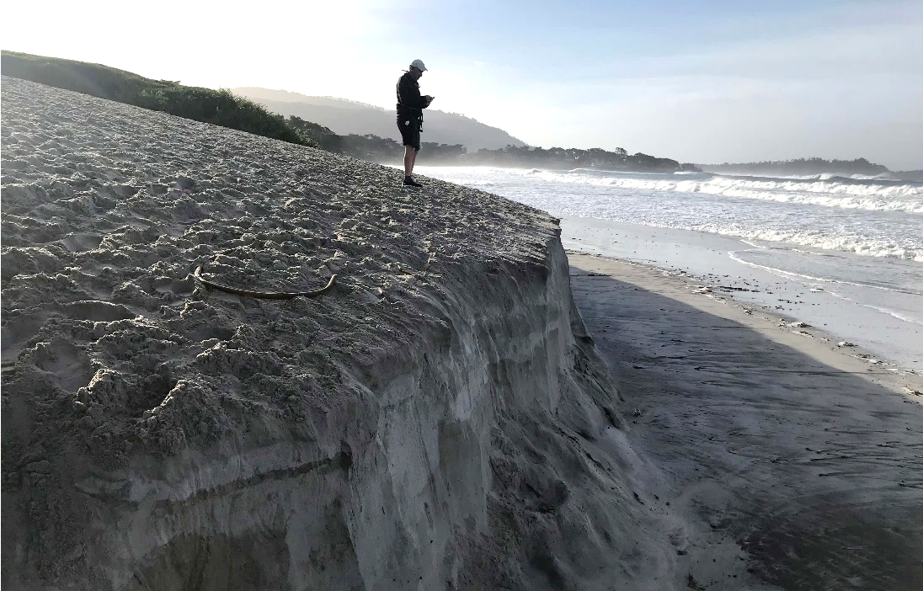
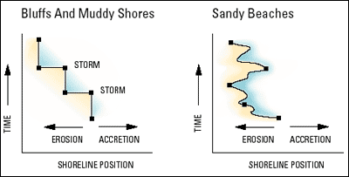
Cliff Erosion vs Sandy Beach Erosion
Bluffs, cliffs, and dunes experience episodic erosion
Bluffs and cliffs do not recover
Sandy beaches experience gradual erosion and can recover
Carmel has a multitude of conditions:
  Del Mar Dunes and North Dunes
  Unarmored cliffs
  Seawalls and riprap, primarily at the southern end of the beach
Pre-Storm Profile
Eroded Scarp Crest
Eroded Scarp Toe

Slide 17
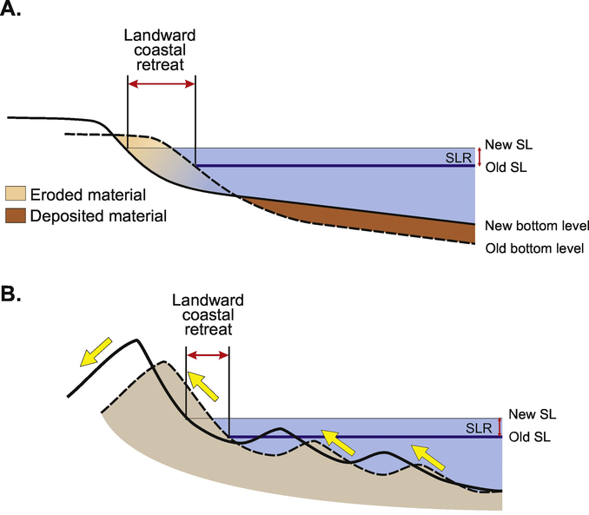
Dune Erosion Methods
Projected dune erosion using FEMA guidance and a “marching back” of the shoreline position
If no sediment is available, “coastal squeeze” occurs
Projected dune erosion out to 1 foot of sea level rise, then transitioned to cliff erosion processes as underlying cliff exposed

Slide 18
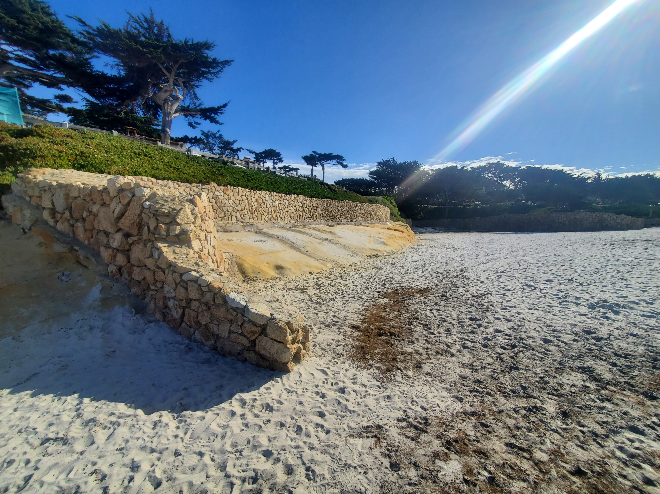

Cliff Erosion Methods
Multiple model approach similar to USGS cliff erosion tool that use historical erosion rates as a baseline
We modeled unarmored and armored conditions, and high, medium, and low assumptions on historical erosion rates.
For the armored scenario, the frequency of wave attack above the top of armoring leads to an acceleration of erosion rates into the future
For the unarmored scenario, a decreasing surf zone width and more wave energy on the cliff drives erosion
SLR
The light blue lines indicate the higher water level exposure with sea level rise

Slide 19
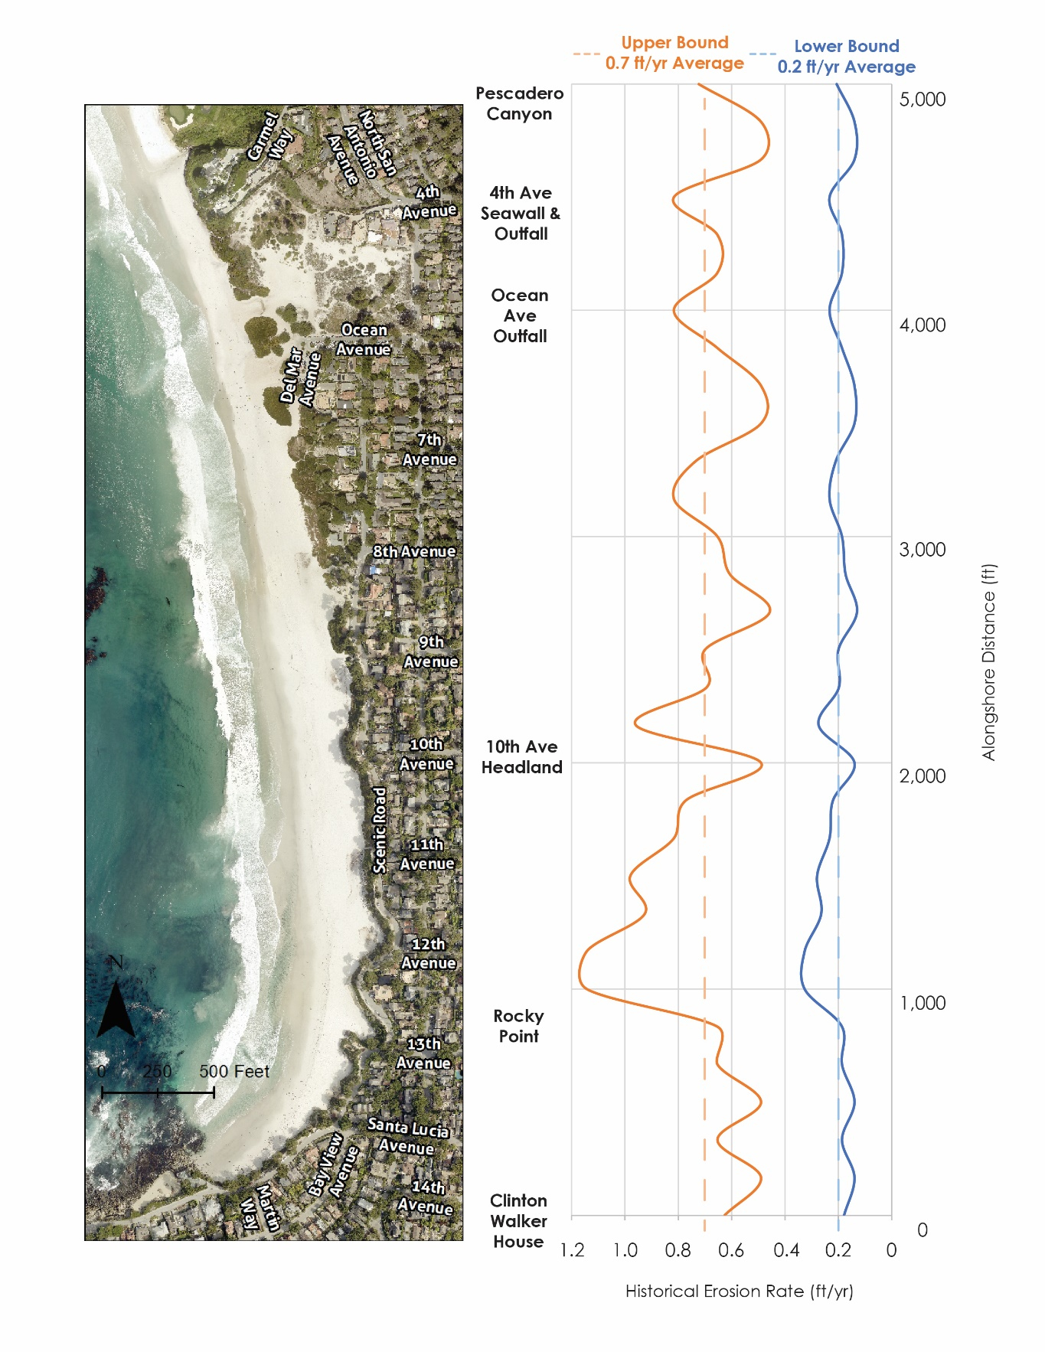
Erosion Rates
Erosion rates establish baseline erosion projections
Erosion rates based on previous studies that determined average rates across entire City shoreline (Rogers Johnson and Associates, 1983)
Location-specific erosion rates were determined for this study based on local geomorphology and wave conditions
Right: the range erosion rates showing the variability about the mean

Slide 20
Cliff and Dune
Overtopping and Erosion
With Coastal Armoring

Slide 21
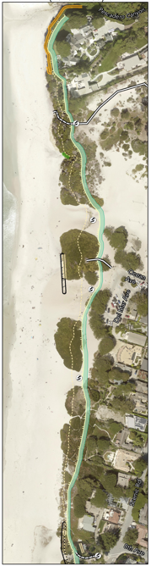
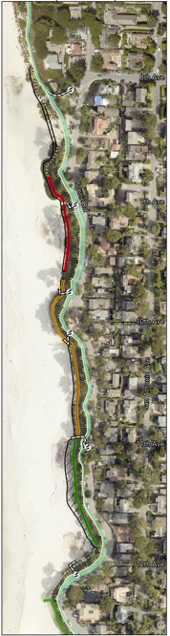
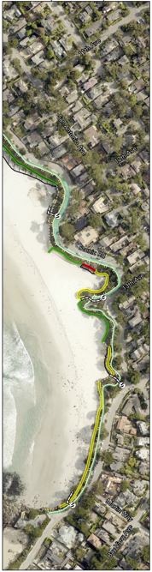
Erosion and Overtopping
Short Term (2045 – 2060)
North
Central
South
Overtopping Potential:
Low
Medium
Medium-High
Very High
Overtopping:
Highest risk between 8th and 10th Avenues
Erosion:
Most threatened area for erosion is at Central Carmel Beach between 8th and 12th Avenues
Red circle indicates an unarmored area of shoreline at Scenic Dr. and 12th Avenue
Erosion hazard area

Slide 22
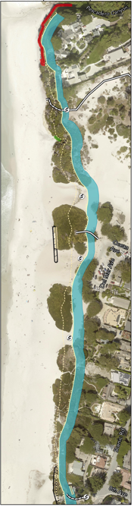
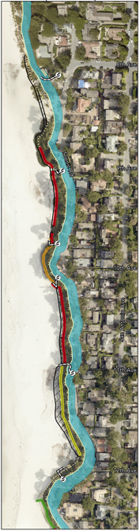
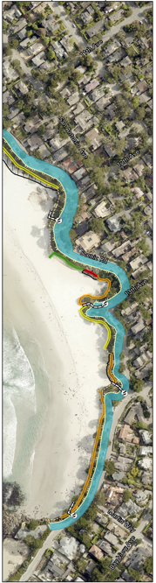
Cliff and Dune Erosion Medium Term (2060 – 2080)
North
Central
South
Overtopping Potential:
Low
Medium
Medium-High
Very High
Overtopping:
Overtopping potential highest between 8th and 12th Avenues
Erosion:
Projected erosion hazards in areas behind seawalls range from 20-40ft
Erosion hazard zones are slightly higher along the dune-backed shoreline
Erosion hazard area

Slide 23
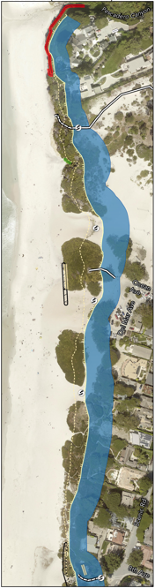
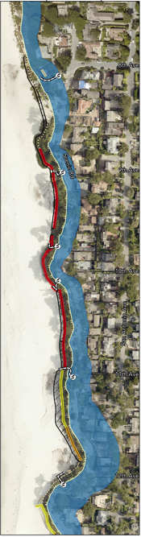
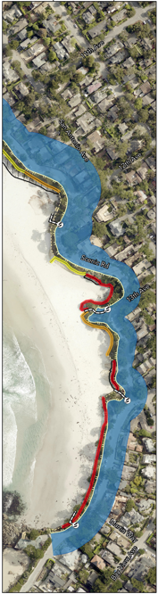
Cliff and Dune Erosion Long Term (2080 – 2100)
North
Central
South
Overtopping Potential:
Low
Medium
Medium-High
Very High
Overtopping:
South Carmel Beach between Martin Way to 13th Avenue
North Beach near Pescadero Canyon
Erosion:
Highest erosion potential around 12th Avenue up to 150 ft (see red circle)

Slide 24
Task 4: Vulnerability Assessment
Assuming no Adaptation in the Future

Slide 25
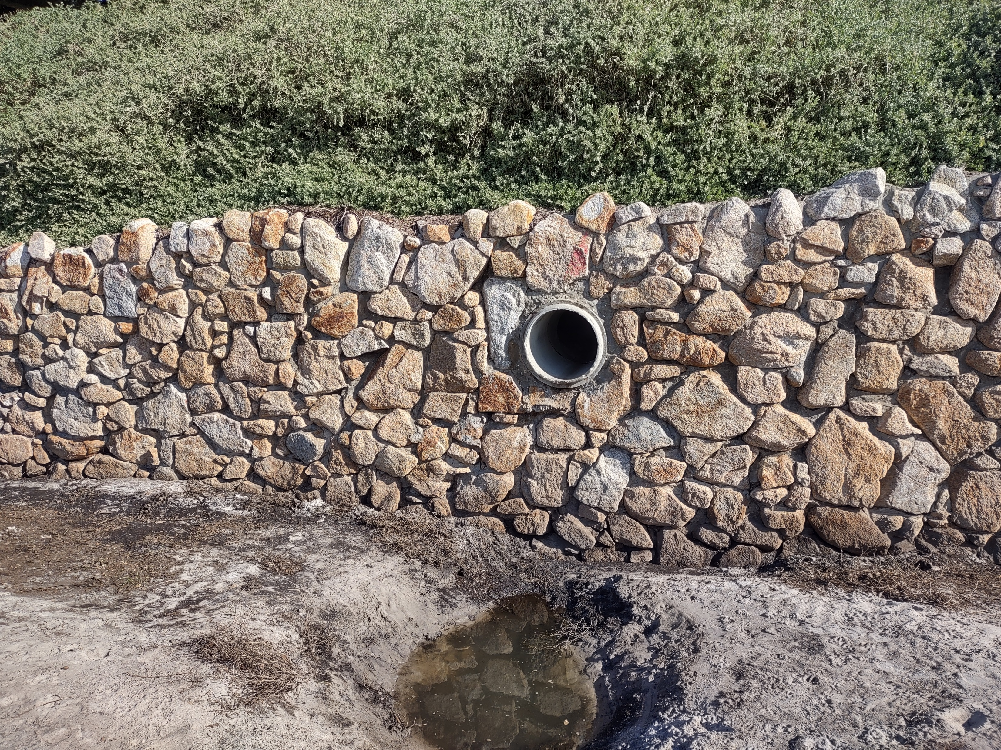
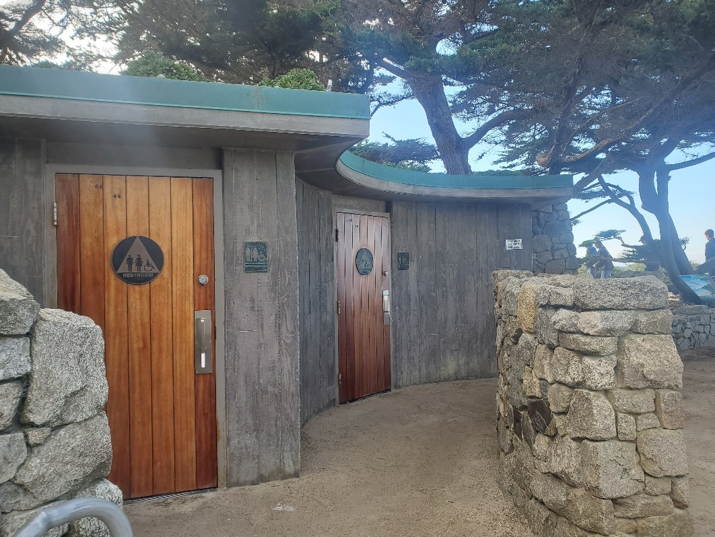
Current Vulnerabilities
Stormwater conveyance
All beach access stairways and the beach overlook at Del Mar
Restroom near Santa Lucia Avenue, located at ~24 ft NAVD 88, which is at the same elevation of the FEMA base flood elevation for this area
Wave splash (not green water associated with overtopping) may exceed the bluff crest of the armored coastline between 13th Avenue and Martin Way and the private seawall near Pescadero Canyon
Stormwater infrastructure
Restroom near Santa Lucia Ave

Slide 26
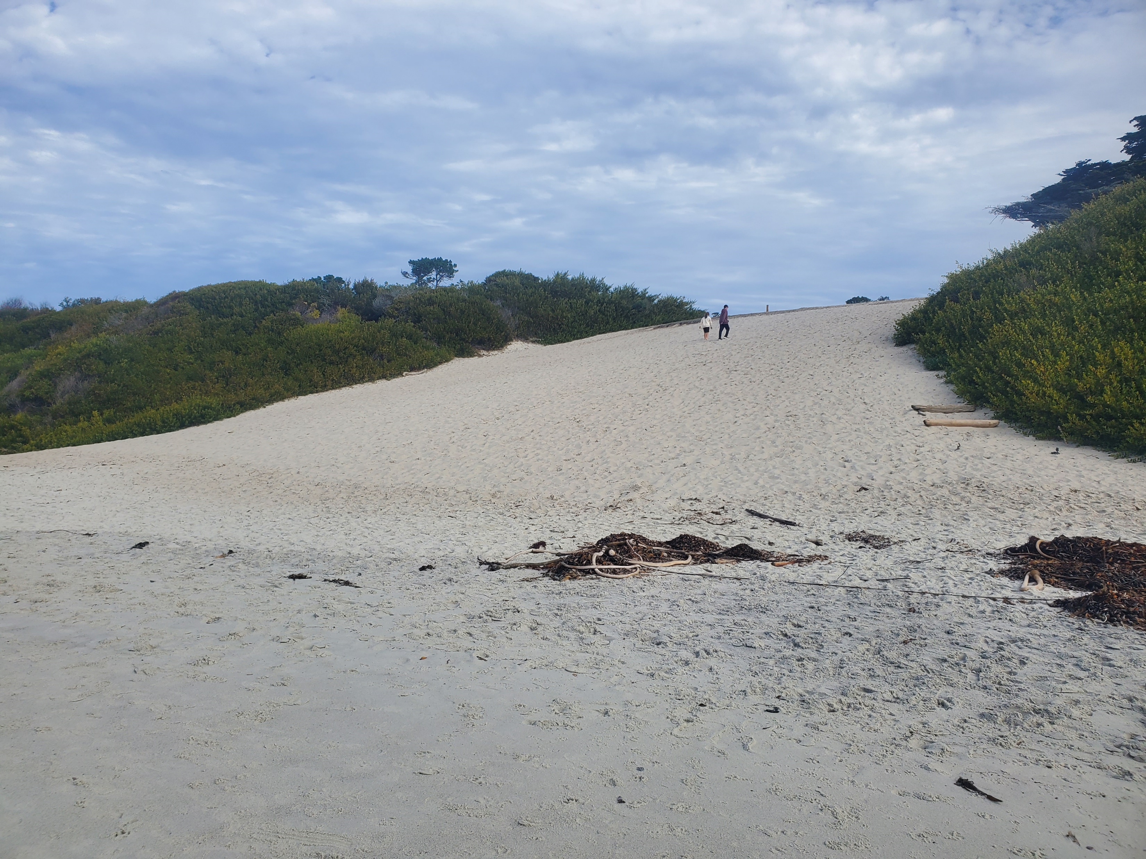
Short Term (1 ft SLR, 2045 - 2060)
Scenic Road is exposed in 6 locations from 8th Avenue and 11th Avenue
Wastewater mains are exposed at:
  Martin Way
  Between 9th and 10th Avenues
  Under dunes between 7th and 8th Aves
The integrity of the sand dune ramps may be at risk
0.2 acres of North Dunes Habitat potentially eroded
During large storms wave splash could be more frequent between 8th Avenue and 11th Avenue
Sand ramp near the Del Mar Parking Lot

Slide 27
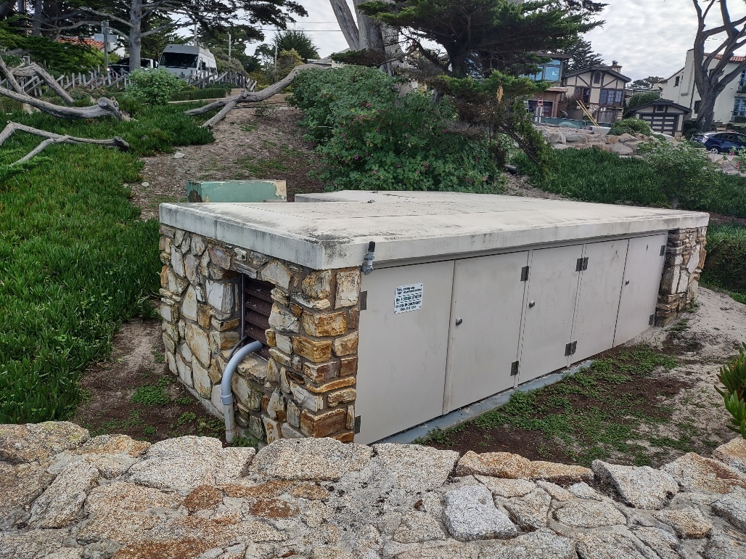
Medium Term (2ft SLR, 2060 - 2080)
Scenic Road: entire length exposed, including underground water and sewer infrastructure
Water main between 8th and 10th avenue
An additional 0.3 acres of dune habitat
During large storms, a wastewater lift station located at ~24.5 ft may be exposed to wave flooding
5 homes may be vulnerable under the without armoring scenario
Wastewater lift station near 8th Avenue

Slide 28
Long Term (2-4ft SLR, 2080 - 2100)
44 homes along Scenic Road and Pescadero Canyon in the with armoring scenario
  Up to 59 homes in the without armoring scenario
Del Mar Parking Lot
0.6 acres of dune habitat is exposed to erosion, for a total of 1.16 acres
Water main under Scenic Rd. at 13th Ave
Sewer main at 8th Ave
Two water storage tanks located near the Del Mar parking lot
Standing water from wave overtopping during storm events is now more frequent everywhere south of 8th Ave
Assuming high erosion potential:
  Restroom at Del Mar Parking Lots
  Volleyball Courts

Slide 29
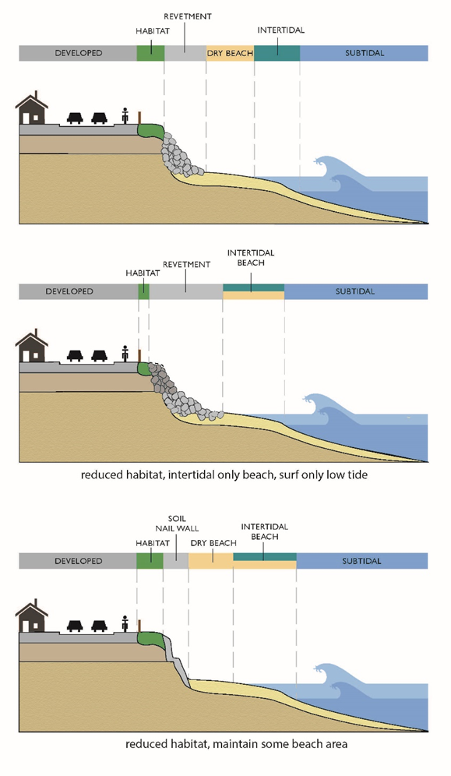
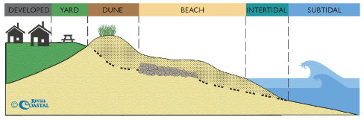
What’s Coming in Phase 2
Intro to adaptation – Protect, Accommodate, Retreat
Community Outreach
Socio-economic Analysis
Weighing different adaptation strategies
  Certainty of success, costs, secondary impacts, co-benefits, expected life of the project
  Developing adaptation pathways over time
Local Coastal Program Policies and Implementation Language updated to reflect community vision and adaptation directions.

Slide 30
David Revell
831.576.2884
drevell@integral-corp.com

Slide 31
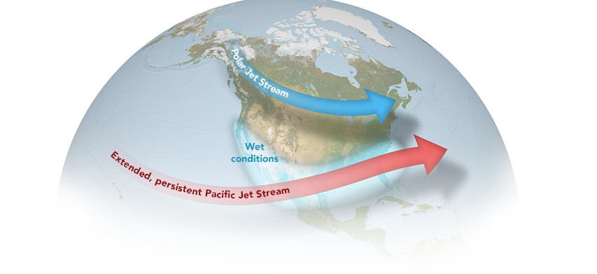
El Niño Effects
Image from NASA Earth Observatory

Slide 34
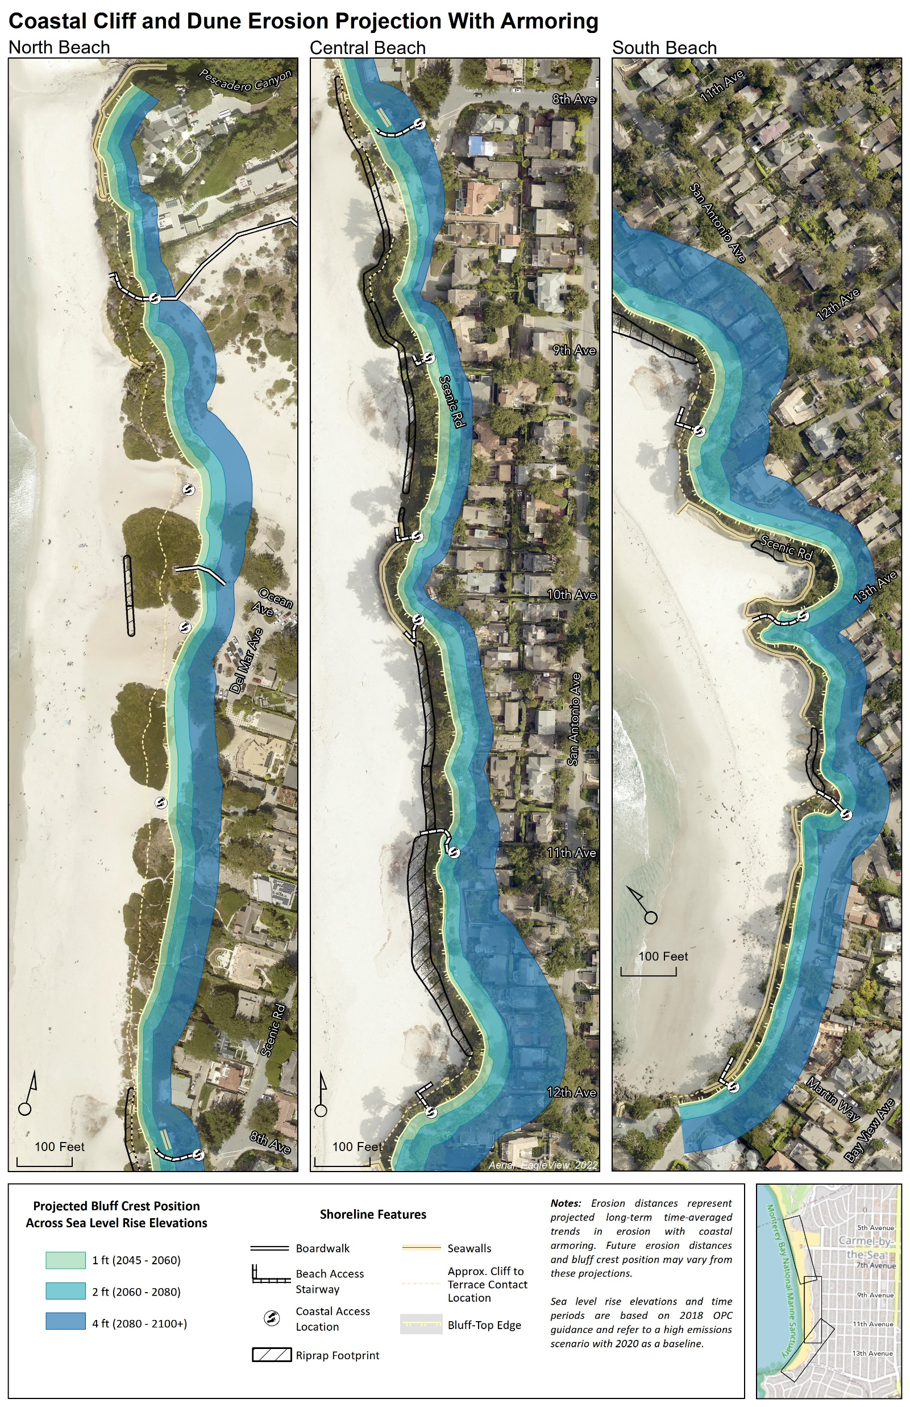

Slide 35
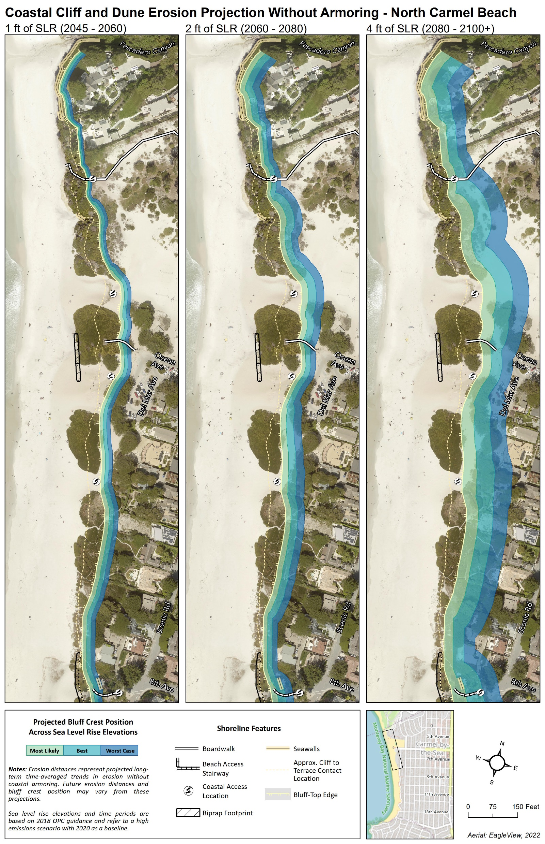
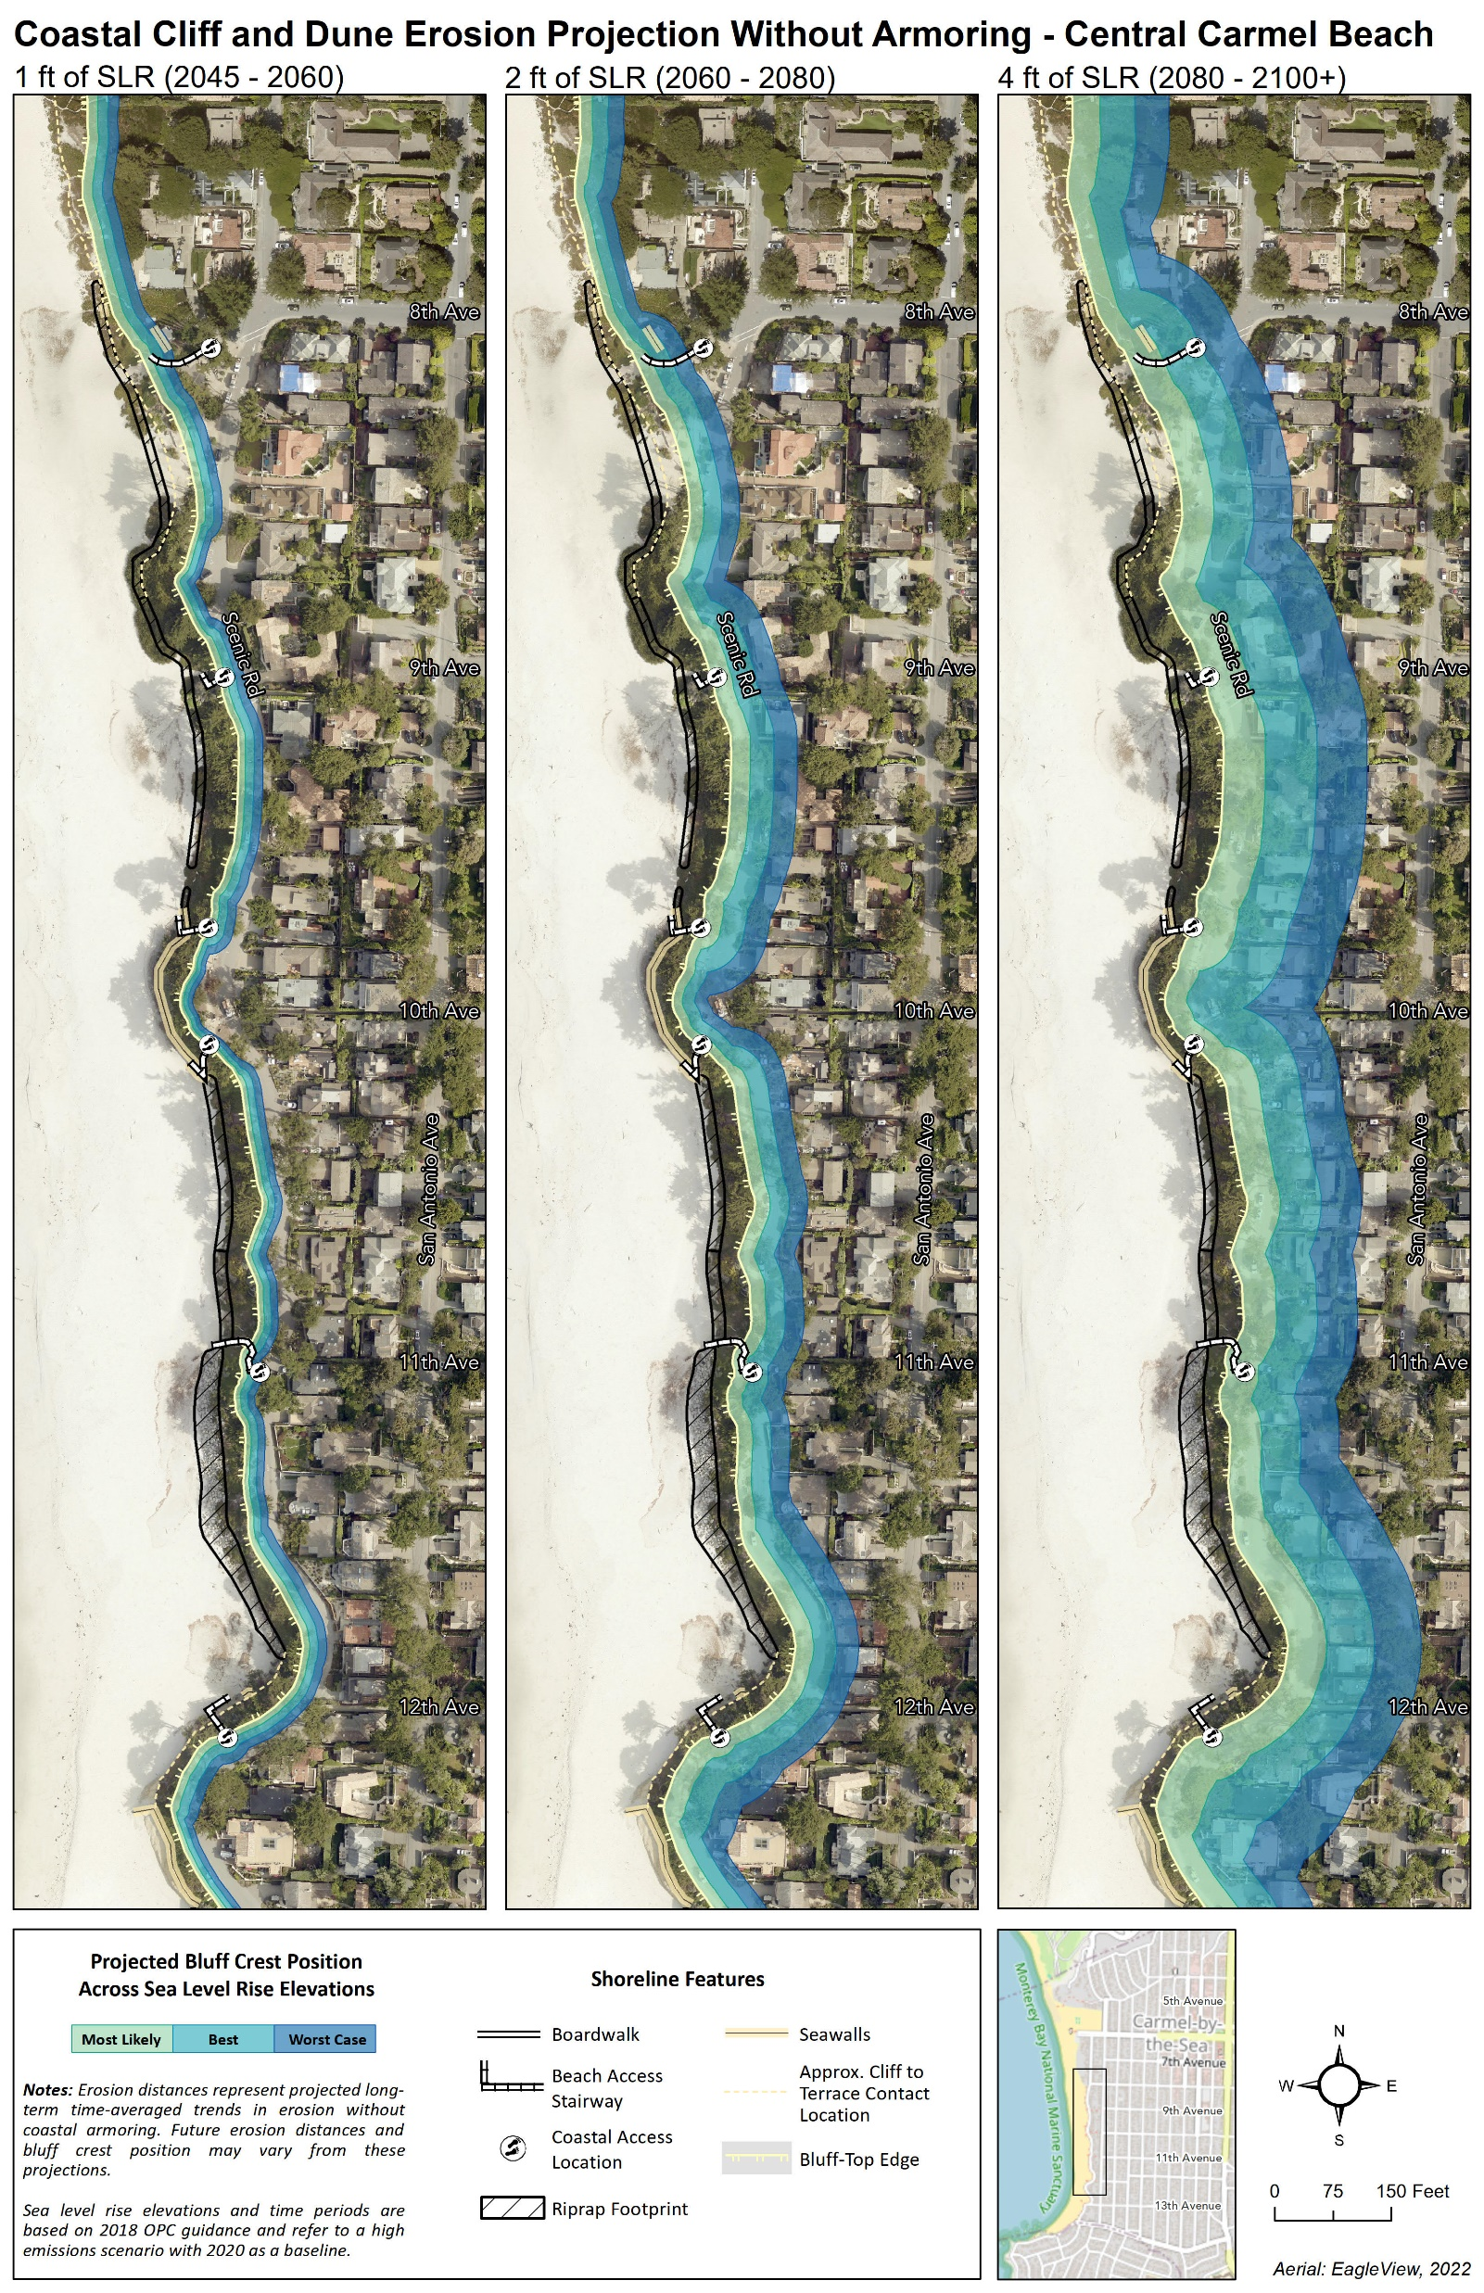

Slide 36
