Slide 1
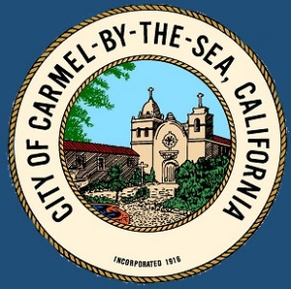
Historic Context Statement Update Workshop
CITY OF CARMEL-BY-THE-SEA
Historic Resources Board Meeting
August 15, 2022

Slide 2
Background
HCS first adopted in 1997
HCS updated in 2008 to cover the period 1940 to 1965
Current update will cover the period 1966 to 1986
Notes:
Adopted 1997
1st Revision 2008
1940-1965
2nd Revision 2022
1966-1986

Slide 3
Overview
The City has received $30,000 in grant funding from the CA Office of Historic Preservation to update the Historic Context Statement to cover the period 1966-1986
The City has contracted with PAST Consultants. Seth Bergstein, PAST Principal, has a longstanding professional relationship with the City and meets the Secretary of the Interior’s Professional Qualifications for historian and architectural historian, as does consultant Kent Seavey

Slide 4
Overview
Subcommittee meetings and public workshops have identified the need to update the HCS beyond the 20-year scope of work funded by the CA Office of Historic Preservation
The City is committed to a “Phase II” of this update effort, potentially involving:
Re-formatting the themes to be chronologically ordered, distinct, and specific to Carmel
Adding photographs throughout
Adding descriptions and character-defining features for all architectural styles
Improving the Prehistory and Hispanic Settlement chapter
However, for the purposes of meeting the grant requirements and deadlines, “Phase I” is largely limited to the 1966-1986 period

Slide 5
Project Timeline
May 16: Kick-off Workshop
June 20: Public Workshop
July 18: HRB reviews Working Draft, seeks feedback from the public
August 15: HRB reviews Final Draft
The workshops and the Working and Final Drafts were “advertised” in the Pine Cone; City’s Friday Letter; and City’s constant contact HCS Update listserv. The drafts were also posted online at the City’s Long Range Planning webpage.
Planning Commission delay until completion of “Phase II”
City Council delay until completion of “Phase II”
Coastal Commission delay until completion of “Phase II”

Slide 6
Final Draft from PAST Consultants
Seth Bergstein
PAST Consultants, Principal
Kent Seavey
PAST Consultants has completed a Final Draft for approval

Slide 7
Historic Context Statement – Existing Themes
Prehistory and Hispanic Settlement: Minor edits (spelling, grammar); inaccurate language stricken
Economic Development: Minor edits; restrictive liquor clauses; new section on Downtown Architectural Development (Carmel Plaza expansion; 1973 commercial building moratorium and 1974 building controls; Wells Fargo Bank; Savings & Loan Building (7th + Dolores); Nielsen Market; impacts of tourism; 1974 ban on new restaurants; demographic changes.
Government, Civic and Social Institutions: 1984 General Plan; use of public property; mayoral elections.
Architectural Development: Mission Trail Park; Picadilly Park; narrative text about architectural styles; “style sheet” pages for 7 architectural styles between 1935 and 1986.
Development of Arts and Culture: Minor edits

Slide 8
Architectural Styles
Minimal Traditional ( 1935-1950)
California Ranch (1940-1986)
Bay Region Modern (1940-1986)
Postwar Modern (1945-1960)
Wrightian (Organic) (1945-1986)
Regional Expressionist (1945-1986)
Post-Adobe (1948-1986)
*Note changes from Working Draft: International Style removed for lack of sufficient numbers of local examples, and Bay Region further specified as “Bay Region Modern”
*Note some styles will pre-date 1966 as many midcentury styles and sub-styles “started” in Carmel in the 1930s and 1940s and continued into our ‘66-86 period (and beyond)

Slide 9
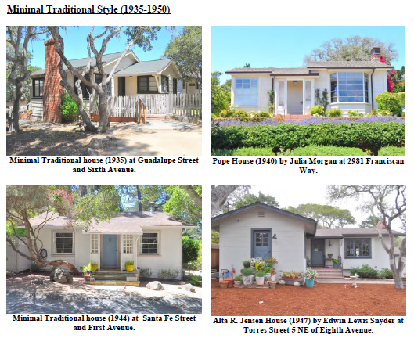
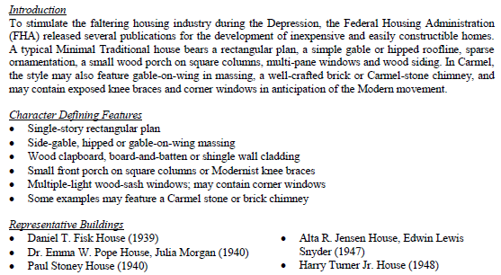
Minimal Traditional Style

Slide 10
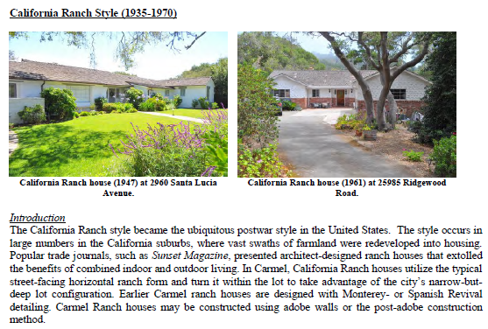
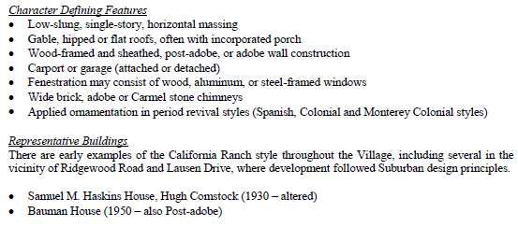
California Ranch Style

Slide 11
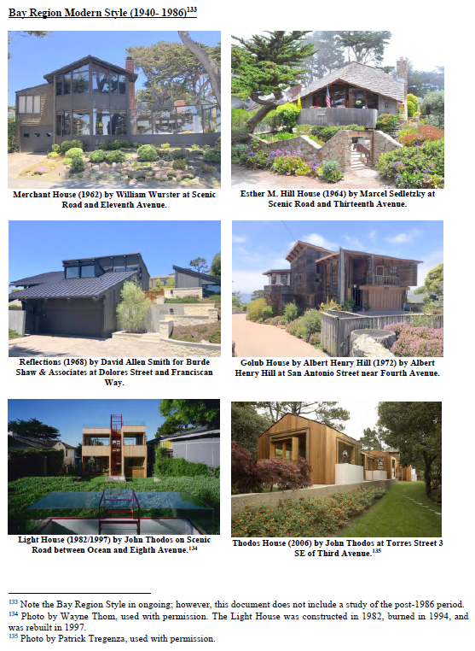
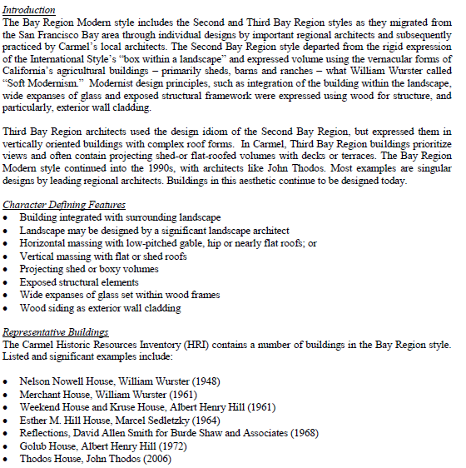
Bay Region Modern Style

Slide 12
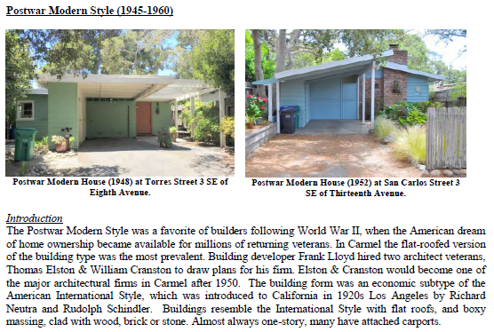
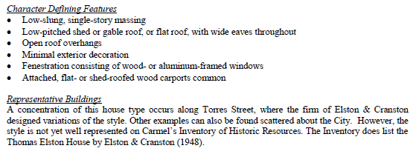
Postwar Modern Style

Slide 13
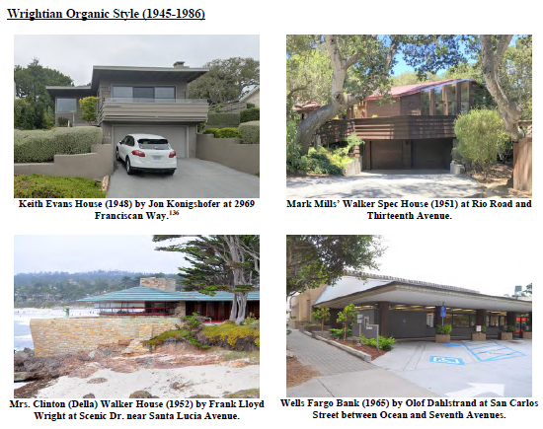
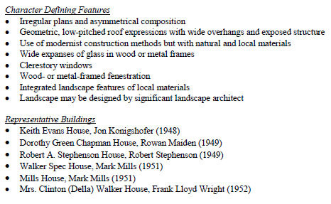
Wrightian Organic Style

Slide 14
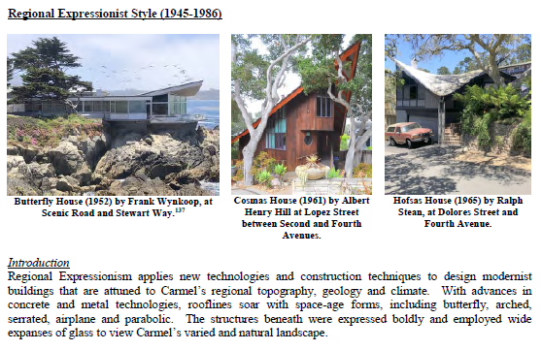
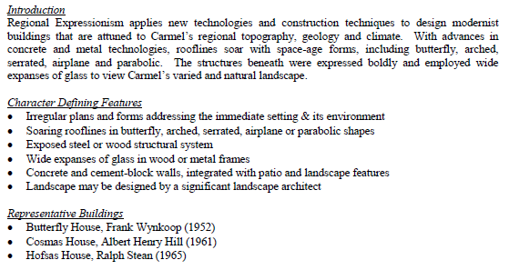
Regional Expressionist Style

Slide 15
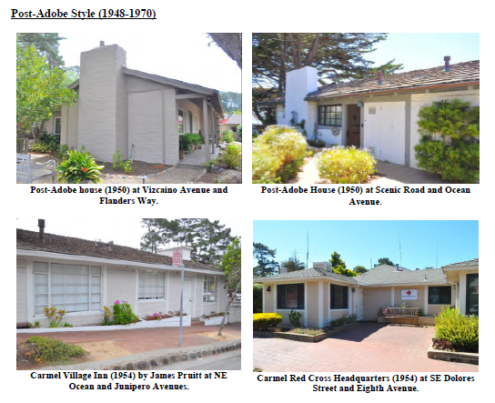
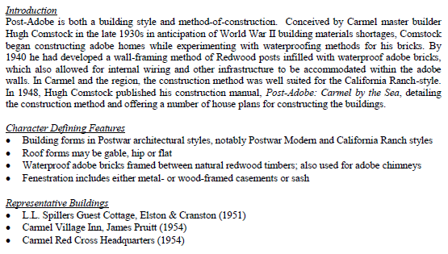
Post Adobe Style

Slide 16
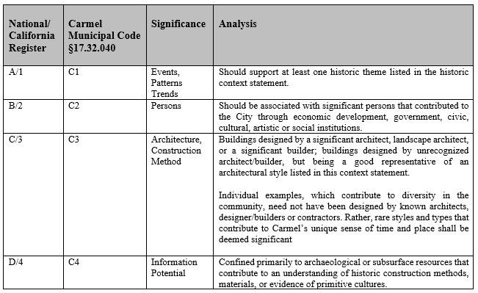
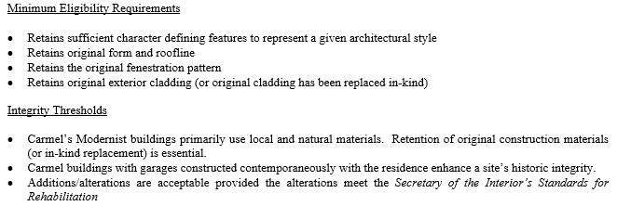
Historic Significance & Integrity

Slide 17
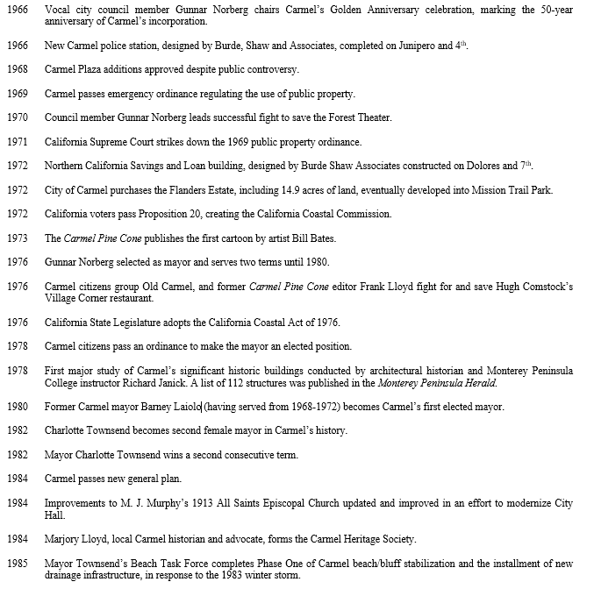
Timeline Updated

Slide 18
Architect Biographies Updated / Added
Richard Barrett
George Brook-Kothlo
Walter Burde/Will Shaw
Olaf Dahlstrand
Gordon Drake
John Gamble
John Kruse
Rowan Perkins Maiden
Mark Mills
Charles Moore
Athanase Nastovic
David Allen Smith
Robert Stephenson
John Thodos
Joseph Wythe

Slide 19
Historic Context Statement Update: Next Steps
HCS Update “Phase I” to be approved by HRB August 15, 2022
Upon completion of “Phase II” in 2023 the updated document will be referred to the Planning Commission and City Council and will be submitted to the Coastal Commission as a Local Coastal Plan amendment

