Slide 1
Traffic Congestion Reduction
AND
Parking Management
For
Carmel-by-the-Sea
Brian Uhler
Notes:
Introduce self

Slide 2

OBJECTIVES
Review Background/History
Summarize Past Council Action
Discussion on Issues and Implications
Seek Council Direction/Next Steps
Notes:
In today’s presentation, our objectives are:
First, to provide a sense of history. In much of the presentation and staff report, you will find references to Carmel-by-the-Sea’s past experiences. To enhance relevance and to meet time constraints, we will focus on just the last 10 years or so…otherwise, we’d need a special, all day meeting. While you might find it fun to talk about traffic congestion and parking management all day, it’s just not practical.
Second, we’ll summarize the past City Council action (in just the last 10 years)
Third, and where we dedicate most attention, will be to relate the key issues and implications. Some of this will will include historical information. In this segment, we’ll be exploring a variety of things like:
the relationship between parking and traffic congestion,
the effects of traffic congestion,
the experience of 2014 parking program, and, so we can learn from it we’ll dig into the community and operational concerns during the 2014,
we’ll be covering the Walker studies to include key data.
Lastly, at the end, we will ask the City Council to provide direction to guide future action—if any.

Slide 3
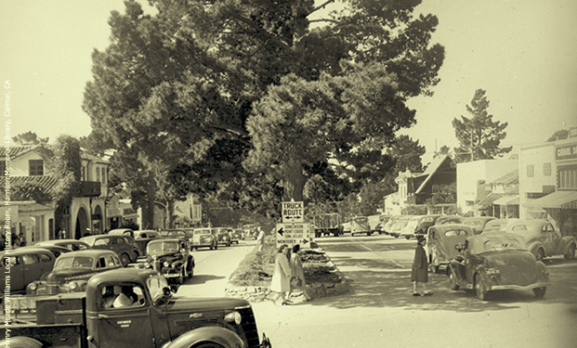
1945 Carmel-by-the-Sea
Notes:
Here’s a photo from 1945, and as you can see, but for the clothing style and how cars look, there’s been little change. Parking spots are full and there’s traffic congestion.
It’s actually kind of cool, to reflect and see how Carmel’s protected itself from things like traffic signals and a big city vibe. As we discuss traffic congestion and parking, we recognize and respect the desire to keep Carmel’s charming, residential character.

Slide 4
Major inflection points
2021: City Council defined traffic congestion and parking a City priority
2014/2015: Piloted kiosks on Ocean between Junipero and Monte Verde
2013: Walker parking study
Notes:
Major inflection points within the last 10 years.
In 2021, the City Council defined traffic congestion and parking management a priority. Through 2022, on two occasions this was reaffirmed by the City Council during periodic reviews.
In 2014/2015, a 7 month “experiment” was conducted on Ocean Avenue—I’ll be covering details on this in later slides.
Lastly, in 2013, we received a parking analysis from Walker which built on a similar 1999 Walker report.

Slide 5
Prior city council action
Approved Community Service Officer positions
Funded two parking studies
Approved experimental paid parking program
Established and adjusted limited time zones
Established free, all-day parking at Sunset Center
Expanded all-day parking on Junipero Avenue
General Plan: Traffic Congestion & employee parking
Traffic Congestion and Parking as a Council Priority
Notes:
To briefly cover the Council’s prior action…
1-The CSO program started in 1970’s and varied between one and five positions—currently there are 3 CSOs
2-The Council approved funding for 2 parking studies in 1999 and again in 2013
3-Acting on some of the recommendations in the Walker reports, CC approved an experimental parking program on Ocean (also, in a 2002, “pay and display” program which was accomplished after the 1999 parking study)
4-Limited time parking zones are now at 2 hours and 30-minute (multiple adjustments over time)
5/6-In an effort to help with employee parking, the Council established free parking at Sunset Center and expanded on Junipero to allow for all day parking.
7-General Plan, in its Traffic and Circulation Element, the plan describes issues of local significance to include
*concern for traffic congestion in the commercial district,
* pedestrian safety, and
* the negative effects of employee parking
There have been multiple instances of this Council and prior Councils establishing a Goal or Priority to do something to manage parking and reduce traffic congestion.

Slide 6
Effects of Traffic Congestion (Residents, Visitors and Businesses)
Air pollution
Inconvenience
Wasted time (driving around)
Driver anxiety
Business impacts
Pedestrian safety
Noise pollution
Visitor frustration/leaving
Resident dissatisfaction
Difficulty for employees
Traffic Congestion
Detracts from Residential Character
Notes:
Here are some of the negative effects of traffic congestion….
A main point here is that traffic congestion is not consistent with our residential character…
probably why the issue keeps getting so much attention over the course of decades.

Slide 7
Traffic and Parking
(1) Limited parking leads to circling in search of a parking space.
(2) Current parking time limits causes visitors and local employees/owners to move their cars (leading to more circling)
Notes:
As pointed out in both parking studies, there’s two main ways traffic congestion and parking in Carmel are connected and related to each other…
First, when drivers arrive in the business district they must first find a parking place. In my personal experience, 10 or more minutes to find a space is not uncommon—even on weekdays.
Second, with a looming parking time limit, visitors, shoppers, and sorry to say, employees and business owners who have parked nearby, need to move their car. Of course, once moved, they circle the area looking for a parking place.

Slide 8
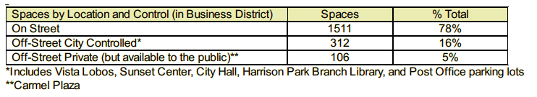
Walker Studies (1999 and 2013)
Among highest occupancy observed in all California
Sufficient, but imbalanced between on-street and surface lots
Time limited parking “vexing” to enforce (as in other cities)
Visitors likely to have difficulty finding parking
Significant traffic from those searching for parking
Parking management would reduce visitor frustration and congestion
Spaces for visitors likely occupied by employees
Notes:
In 1999 and again in 2013, the City hired Walker Parking Consultants
Since there’s been very minimal changes to the streets, traffic patterns, or economic indicators, the findings and information reflected in these reports is still accurate and can be relied upon.
Key quotes from Walker include:
Highest occupancy in all of California
Sufficient parking availability—the study just points out we need to improve use of places like Sunset Center, Vista Lobos, and other all-day parking areas in order to relieve the highly congested commercial area.
Use of time-limited parking enforcement is ineffective, specifically against employees who know how to ”game the system”
Visitors, as pointed out in the study, will have difficulty finding a parking space
The study points to a significant traffic increase by those searching for a parking space
Parking management, through the use of paid parking, would help with visitor frustration and traffic congestion
The data reflected in these reports shows how at one time, over 1000 spaces being recommended for paid parking.
More recent staff estimates suggest an effective program could include reducing the footprint of paid parking to less than half of the 1511 on-street parking spaces in or near the business district.

Slide 9
2014/2015 Parking Experiment
Positively impacted availability on Ocean (but spillover)
Quantity, appearance and size of kiosks -- biggest issue
Paid parking symbolized the opposite of residential character
Businesses worried about losing patrons going elsewhere
Deployed during the holiday season
Opposition formed -- adjustments to respond were too late
At end, business leaders suggested self-monitoring employees
Notes:
The program adopted in 2014, positively impacted parking availability—but generated “spillover” impacts in nearby free parking areas.
Community outcry, mostly about the appearance and size of paid parking kiosks, led the City to abandon this paid parking initiative.
As cited in the news stories, attached to the staff report, many people were concerned with this imagery of paid parking infrastructure, not representing residential character at all.
Program critics, especially business leaders, cited the inconvenience of making payment as potentially causing patrons would go elsewhere.
Rolling the program out in early December was an issue.
During the program, there was late recognition of need to “take care” of employees, locals, and businesses. By the time the City made adjustments (like vouchers, local permit benefits, and more employee parking areas), there was already a firmly-held, groundswell against the program.
When the effort was abandoned, business leaders suggested they could favorably impact employee parking. Understandably, business owners and managers attention level on this seemingly benign topic is difficult to maintain over time.

Slide 10
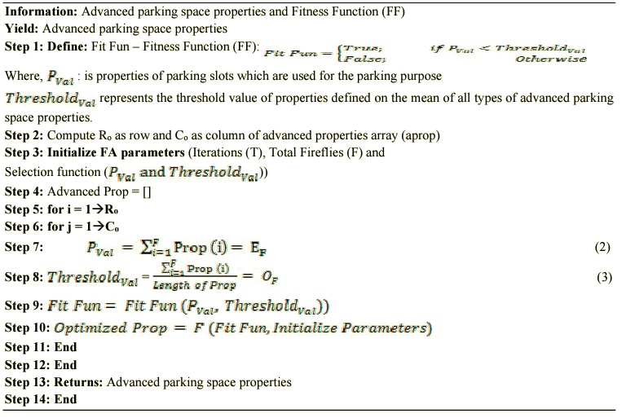
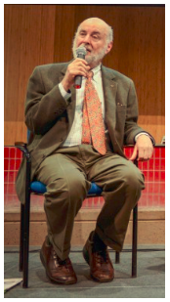
www.shoupdogg.com
Notes:
We’re now transitioning from historical information to a critically important scientific mathematical model. If at first glance it doesn’t make much sense, no worries, I’ll explain all of it…actually, don’t worry, we’re not doing any math…what’s worth mentioning: there are scientific journals, books, and entire fields of study focused on parking. A professor at UCLA, Dr. Donald Shoup, has built his entire life around parking. He’s kind of a superstar in the urban planning world and goes by “ShoupDogg”…he also has protégés in the urban planning world called “Shoupistas.”
He has a website: Shoupdogg.com….if you’re intellectually curious, check out his “parkumentaries” where you can learn about things like “the High Cost of Free Parking”
BTW: I’m betting Council member Baron or maybe Brandon Swanson would totally get into the math problem.

Slide 11
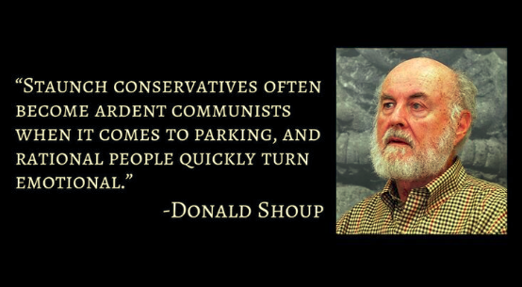
Notes:
Our nation’s foremost expert on the topic, says (read quote)
This seems to reflect Carme’s experiences as well.

Slide 12
Does Carmel really have a Traffic Congestion problem?
Let’s Compare with
San Francisco
Notes:
I bet everyone would agree, that downtown San Francisco does not have a “Residential Character”

Slide 13
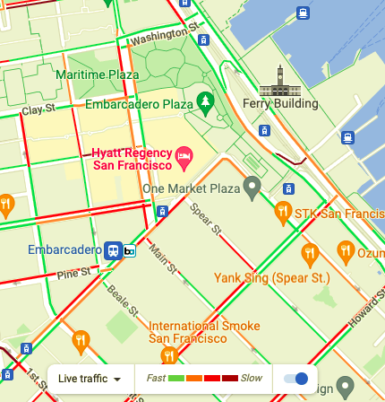
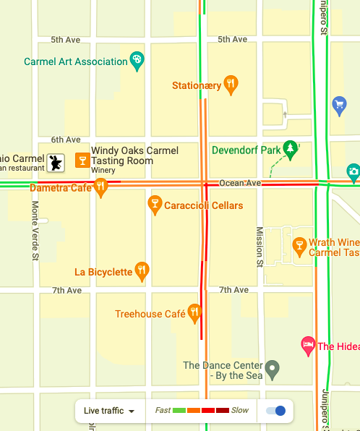
4 days ago
2 pm traffic
San Francisco
Notes:
Here’s 2 pm traffic, 4 days ago.
Please note: some green, some orange, and some red
As you would expect….

Slide 14
4 days ago
2 pm traffic
Carmel
Notes:
Here’s Carmel’s commercial core at the same time…
We are just like downtown San Francisco… minimal green, mostly orange/red.
Certainly, not in keeping with a “residential character”

Slide 15
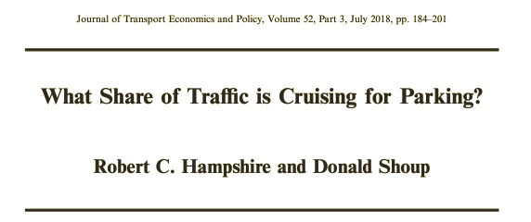
Search for parking
22 studies in 15 different cities showed an average 34% of traffic was cruising in search of a parking space.
San Franciscans Spend 83 Hours Per Year
Looking for Parking
Source: Cited by Sfist.com
Notes:
Donald Shoup examined many different parking studies to determine 34% of downtown traffic was people circling for parking.
While not necessarily something you equate with Carmel, San Francisco residents spend 83 hours per year looking for parking…
Remember the slide comparing SF to Carmel?

Slide 16
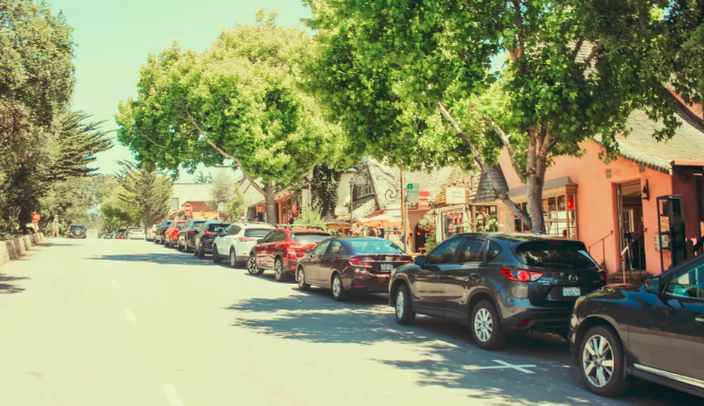
Scope of Traffic Congestion
Count the number of cars passing an empty parking space
Notes:
Here’s the simple way to measure Traffic Congestion: Imagine your watching a Carmel street around lunch time, and you notice a car leave a parking space.
Count how many cars pass without parking in the newly vacant parking space…if do this, you’ll be conducting parking analysis Shoupdogg style.
Results will vary by time and day of the week.
While this method is overly simplistic, if you watch several occurrences, and count total number of cars passing before parking spaces are taken, you can estimate the percentage of cars circling for parking.
For example, if you consistently see 9 cars pass a parking space before being taken by the 10th car, then roughly 10% of all traffic is cruising (or circling) in search of a parking space. Worse (and probably more accurate for Carmel)….if you see, over time, an average of only 3 cars passing before a spot is taken, then 25% of all traffic is in search of a parking space.
In an ideal setting, through parking management, there’s one or two empty spaces on every block, which would result in arriving visitors finding a parking place without the need to circle at all.
A sort of mean way to gauge this is to walk around with keys and act like you’re about to get in a car and leave. See how often a circling, and hopeful driver notices you and slows down thinking you’re about to leave a parking space.

Slide 17

The parking professional (Sept 2018)
Study of 1000 participants found:
76% avoid traveling to certain areas because of a perceived lack of parking.
Notes:
Remember earlier, when I mentioned how our own residents may avoid Carmel’s busy commercial district?
Or perhaps you have heard from an exacerbated Carmel visitor who complains about how long it took to find parking…
This study, featured in ”The Parking Professional” magazine, found 76% of respondents would avoid traveling to certain areas because of a lack of parking.
With this in mind, it could be argued that Carmel businesses would have an improved “bottom line” if more visitors didn’t have a bad parking experience.
Based on this statistic, we can only imagine how many people are avoiding Carmel.

Slide 18
Goldilocks Principle of parking
Charge too Little (or free)
No on-street parking
Traffic congestion/pollution
Employees impact availability
Loss of customers
Charge too Much
Vacant parking spaces
Loss of customers
Right Price
Lowest price to keep one or two spaces open per block to provide convenient access
Notes:
Professor Shoup and others have relied on this Goldilocks principle to explain parking policy questions…
Clearly, figuring out how to arrive at the “right price” is not an easy task
It is dependent on real world results
It’s too early to have dialogue on costs for Carmel…
Suffice it to say…applying this principle….the evidence of actual traffic congestion and lack of on-street parking, suggests the current price is too low.

Slide 19
Reasons to reengage
Traffic congestion and limited parking still a problem
Rising concern about pollution demands action
Technology now allows for fewer or no kiosks
Employee parking still adds to the problem
Society more accustomed to new technology
Traffic congestion and limited parking still a problem
Rising concern about pollution demands action
Technology now allows for fewer or no kiosks
Employee parking still adds to the problem
Society more accustomed to new technology
Notes:
So, given the history and strong feelings on the topic, why even consider changes to parking?—Reading the Pine Cone stories attached to the staff report, the easy path would be to abandon the topic altogether and forever accept traffic congestion and parking chaos. Now that 8 years have passed since the last serious attempt, it might be time to consider trying to deal with it…
First, the problems associated with traffic congestion and limited parking continues. Interestingly, some people who don’t like the community being overwhelmed with visitors, also oppose paid parking because it doesn’t match the residential character…It’s possible that some people might view the idea of making visitors pay for parking as a means to reduce tourism impacts.
Second, pollution, both noise and air pollution is an issue which is worth addressing.
Third, The overarching problem with the 2014/15 parking program centered on kiosks and their mismatch with aesthetics…new technology is smaller and may allow for many fewer or zero kiosks.
Next…the employee game of cat and mouse game continues.
Lastly, In 2014, the pay-by-phone option required a cumbersome app download. Now, no download is needed. Patrons can use a Q-code or Text to number for automated connection via a cell phone.
Society is now much more accustomed with this concept and paying for parking can now be accomplished more easily than before.
Technology also now allows for local businesses or innkeepers, who are concerned about convenience for their VIP customers, to enter and pay for parking on their customer’s behalf—all they will need is a license number.

Slide 20
Future themes
Lessons from past efforts represent an opportunity to adjust and ensure…
(1) effective traffic congestion reduction, and (2) results-oriented parking management
New tech: Option for free resident parking
Design/extent of program should be derived from public input and City Council leadership.
Future parking dialogue should be as
non-adversarial as possible
Notes:
To make every possible effort to get residents participation in the commercial district, through new license plate focused parking systems, free parking could be availed to all residents of Carmel-by-the-Sea. Clearly, City Council would ultimately decide such a concept, but building-in this concept early, might serve to break down old barriers.
As Dr. Shoup said, rational people quickly get emotional when talking about parking. The history in Carmel probably predisposes many residents and business owners with strong feelings. Great transparency, and a careful, measured approach may help all concerned get to a place where real progress is possible.
Ultimately, it would be hoped…a robust public engagement program might serve to make the topic and conversation as non-adversarial as possible.

Slide 21
Council direction
Question 1: Timing of community outreach
The next phase to advance the parking/traffic congestion issue includes a series of public outreach efforts. This public engagement is needed to thoroughly explain the need for paid parking and to design a program which is well-planned and meets the public’s expectations.
Options:
Start immediately, expedite to get an action item to the current
City Council on December 6, 2022
Start public engagement activities in January, after the new City Council is seated, with plan to bring back an action item in May 2023
Wait and seek direction from new City Council in 2023
Other options as directed by Council
Notes:
This concludes my formal presentation…
There’s two slides representing each of the two items describing our sought direction from City Council.
Here’s the first, relating to the timing of community outreach.

Slide 22
Council direction
Question 2: Type of community outreach
As outlined in the “Draft Community Engagement Plan,” a variety of public outreach efforts are proposed, to include:
informational mailing,
resident meetings,
business meetings,
farmers market booth,
restaurant/innkeepers meeting,
Planning Commission meeting, and
City Council workshop.
Options:
Consensus on the draft engagement plan
Modifications as needed
No action—present the question to future City Council
Notes:
Here, we seek direction on the type or content of community outreach. There’s an attachment to the staff report which describes each of these items.

Slide 23

Thank you
Workplace Investigations
Human Resource Services
CEO & Executive Evaluations
Project Management
Public Works
Economic Development
Training & Coaching
Elected & Appointed Board Governance
Organizational Audits
Parks & Recreation
Use Planning
Transit Demand Management
Providing Innovative and Practical Solutions for our clients for over 10 years
Solutions-MRG.com 866-774-3222

