Slide 1
City Prioritization, Data, and Actions Related to Tree Concerns
CITY OF CARMEL-BY-THE-SEA
Forest and Beach Commission Meeting
04/13/2023
1
Notes:
Save Qs for end. Slide # is in bottom right of each slide.

Slide 2
Goals of Presentation
To provide a transparent overview of:
How the City manages storms and recovery efforts
The City’s methods of addressing ongoing tree concerns
To receive feedback from residents and Commissioners
2
Notes:
We have listened to concerns, continue to. Sat down w/ residents, homes.

Slide 3
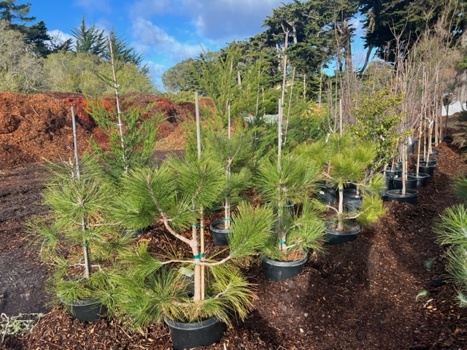
Intended Outcomes
Ongoing: Residents feel safe in their homes and have a peace of mind that the urban forest is being adequately cared for
Today: Residents understand the City’s procedures as it relates to tree prioritization, maintenance, and permitting: provide feedback accordingly
3

Slide 4
Questions This Presentation Will Answer:
How does Forestry manage storm efforts?
Criteria for removing trees on emergency basis?
How is the City prioritizing tree assessments and removals?
How fast or slow is the City issuing tree permits?
When will stumps and storm cleanup be finished?
How will the urban forest be managed moving forward?
4

Slide 5
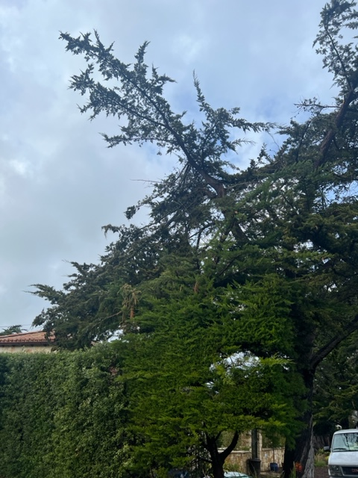
Presentation Outline
Storm Information
Fiscal Impact
Prioritization of Work
Condition of the Forest
Questions & Feedback
5

Slide 6
Storm Data (March ’23)
*The above data is for March 2023 only. January storms resulted in loss of 38 trees, for a combined total of 115 trees lost in 2023 storms: 47+30 (in March) +38 (in January).
Pending assessment:
Of the trees that fell (or were removed):
Which did the City already have on the removal or pruning list?
Which Priority Category (Low, Medium, High) were each given?
Which were healthy?
What types of soil were the fallen/removed trees grown in?
6

Slide 7
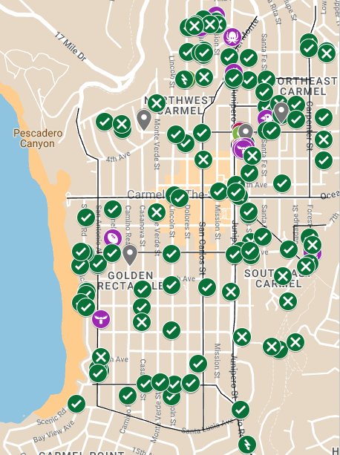
Storm Data (March ’23 cont’d)
Incidents:
Soil Layer:
7

Slide 8
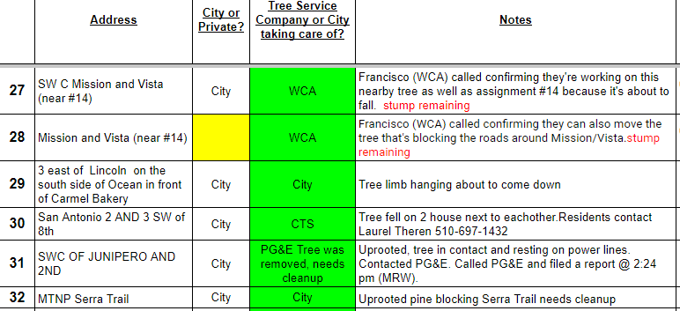
Storm Management
3 crews of 3 Public Works staff in the field
9 City Hall staff assisting
4 Public Works personnel receiving calls (831-620-2070)
18
Notes:
What it looks like in reality.
City Hall Staff Members, Rob Culver

Slide 9
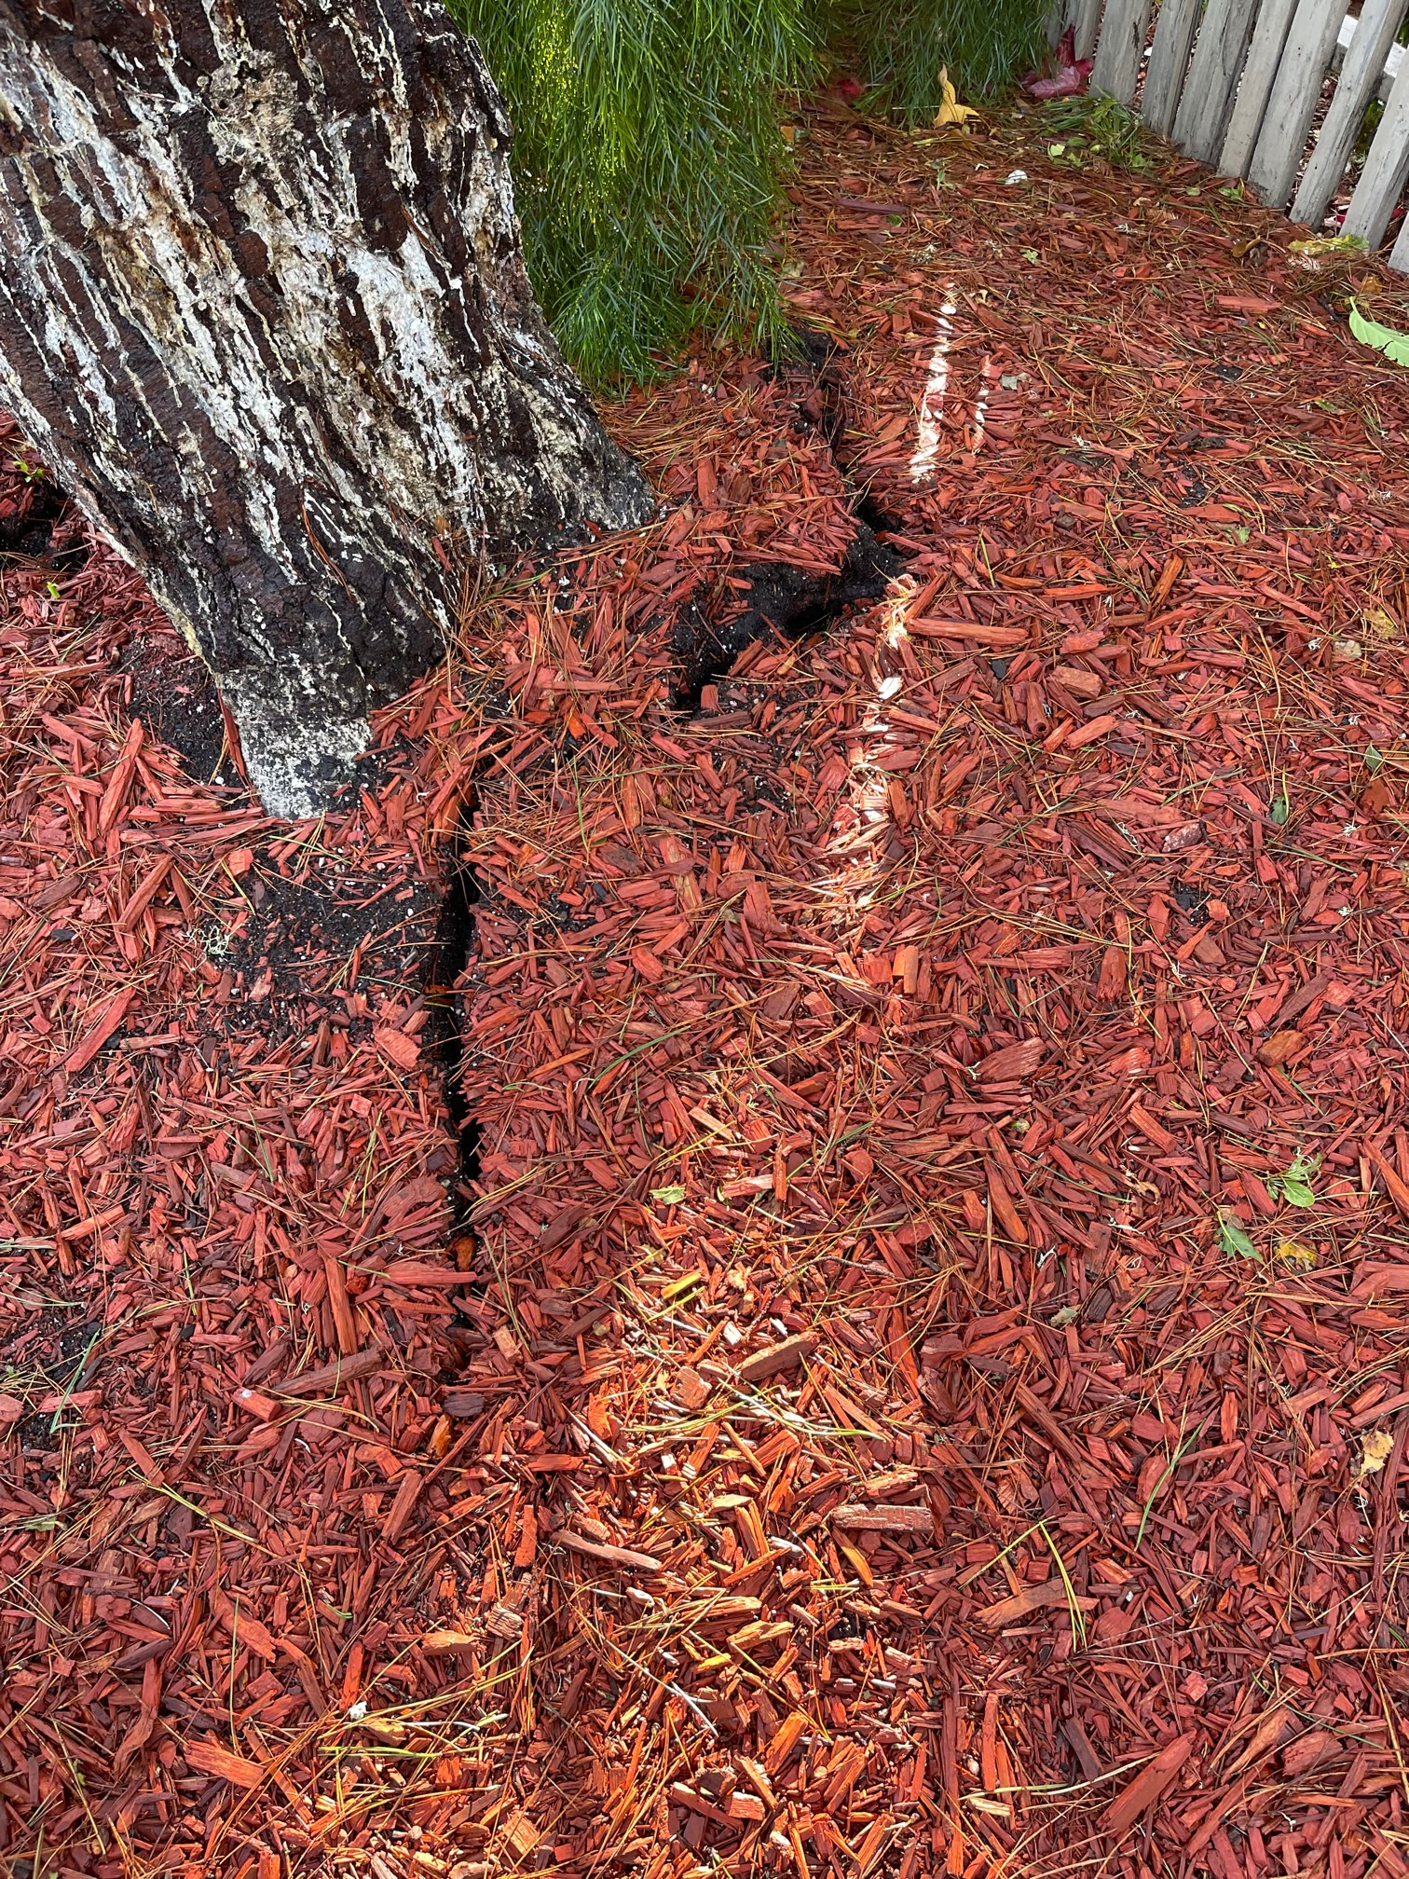
Storm Management (cont’d)
Prioritization of Storm Response:
Fallen trees & power lines
Actively Uprooting
Hanging limbs over streets & walkways
Abnormal Leaning
Non-Threatening Hanging Limbs
Debris Removal
9
Notes:
Photo
Arborist present during all storm days
Debris removal is ongoing.

Slide 10
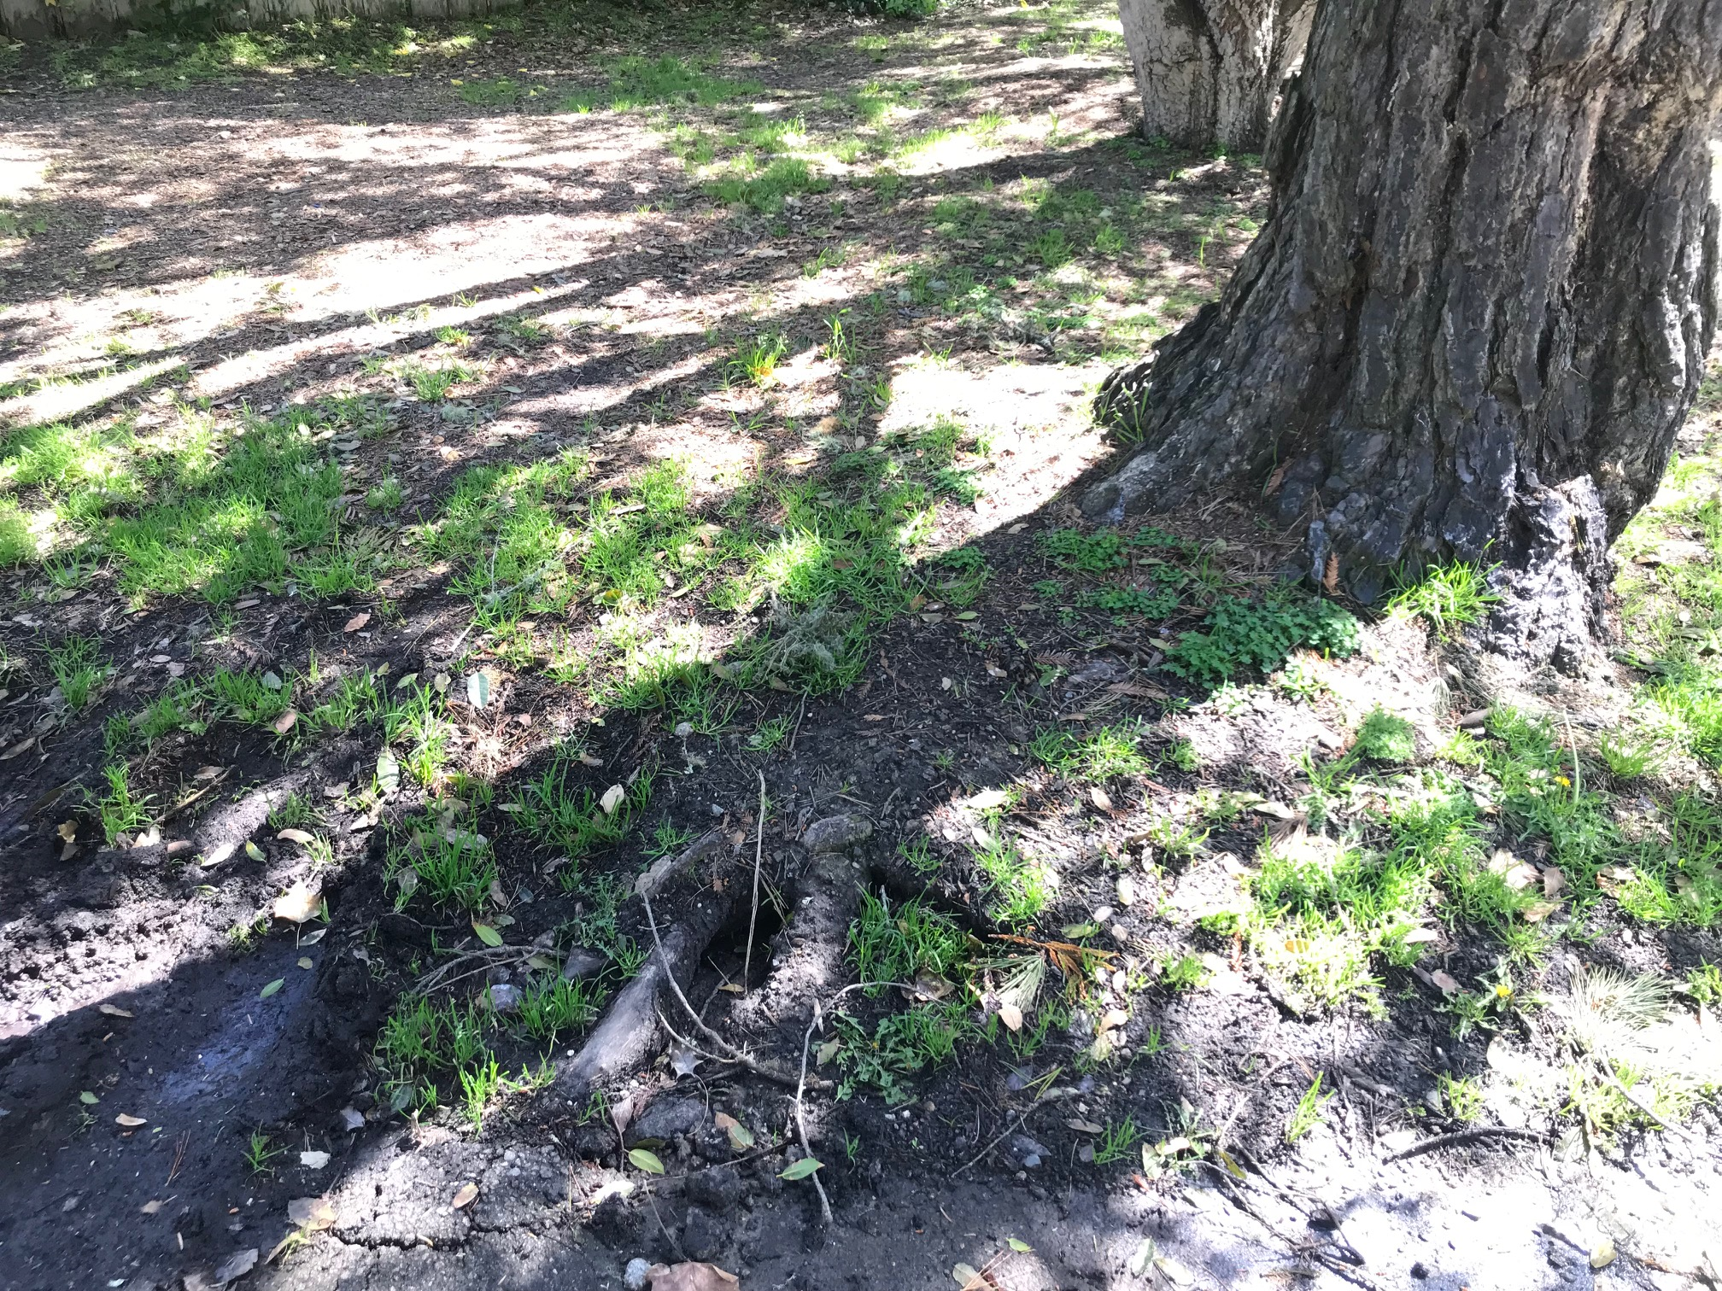
Storm Management (cont’d)
10

Slide 11
Fiscal Impact (March ’23 Storms)
$123,000 received in invoices so far
~$15,000 awaiting invoices
~$12,000 in overturned stump removals
~$50,000 in High Priority jobs currently being worked
Estimated Invoice Total from Contractors: ~$200,000
11
Notes:
- Will have to go to Council for additional funds beyond the 150k in our tree services contract
$122,913.88 total invoices received
- $300k in tree service contract for next FY

Slide 12
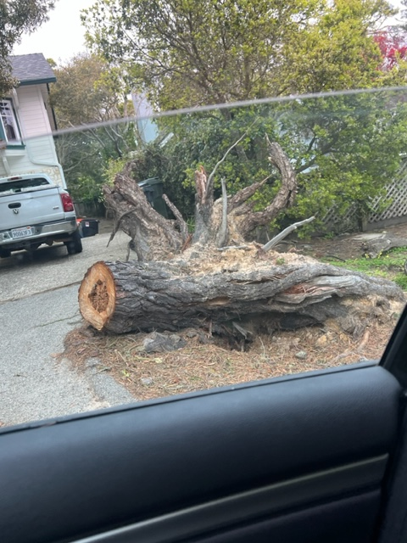
Non-Storm Tree Prioritization
How is the City prioritizing tree assessments and removals?
Low, Medium, or High risk assessment:
Current #s:
Low: 23
Med: 58
High: 46 (contracting ~30)
Stumps: ~500
12
Notes:
- Time Sensitive: over one year, regardless of status
Bare bones of what it takes to manage urban forest: Data on trees, A plan, Staff, Money

Slide 13
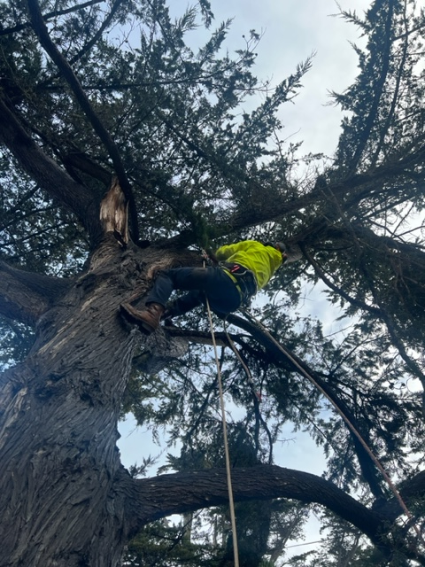
Non-Storm Tree Prioritization
City Tree Crew:
3 Removals/Prunings per week
99 trees/3 per week = 33 weeks (8-9 months)
Scenario: 3 trees added to list per week
Stumps:
Goal of 200 in FY 23/34
Goal of 100 in years following
13
Notes:
In-house goal: commit tree crew to exclusively work on scheduled tree matters 3-4 days a week. Other day or two: watering, planting, resolving tree matters as they arise (broken branches), people have days off, weather permitting, much of the same crew is in charge of landscaping, stump removal, tree planting, watering, beach care, filling Mutt Mutts, etc etc etc.
Bare bones of what it takes to manage urban forest: Data on trees, A plan, Staff, Money

Slide 14
Permits (March ‘23)
70 permits received
62 of 70 permits issued.
Average turnaround time in March:
→ 7 days (including weekends)
--------------------------------------------
~150 permits waived on emergency basis.
14
Notes:
Of 8 not issued:
3 need additional info
3 under review
1 shared ownership dispute
1 unpaid
- Average turnaround time was 3-4 weeks before storms, afterwards, we have cut that time by about 75%
- We print those out for the arborist, so when he comes in, he goes right out to the field. We do the paperwork on our end.
- CMC authorization to temporarily remove the normal requirement of permits for emergency tree work, during emergencies. We did that. Most people followed rules.
- 17.48.040 : “The requirements of the chapter may be suspended, waived, or altered by the City Forester, in the case of a natural emergency such as a windstorm, earthquake, or flood. ”
- Residents submit permits. Advantage: tracking.

Slide 15
State of the Forest
Aging forest
Reduced budget & staffing during/after Covid19
Drought → Heavy saturation + winds from storms
10,000 City trees:
Currently assessing health of trees via Davey Resource Group (DRG):
Propose planting locations based on weighted criteria
Provide a Tree Species Palette based on Carmel’s environmental conditions
15
Notes:
Propose planting locations based on weighted criteria (soil permeability, root zone, slope, canopy connection)
Provide a Tree Species Palette based on Carmel’s environmental conditions (soil type, soil saturation/retention levels, temperature, wind, climate fluctuations)

Slide 16
State of Forestry
After Forester’s departure, 1 full-time Forestry staff
Brought on consulting arborist, Justin Ono
Conducts inspections for tree permits
Onboarded full-time temp to assist Forestry, Louise Shurvinton
Assists with permit logistics, communication with residents/contractors
Forester Recruitment Update: Finalists are being interviewed
16

Slide 17
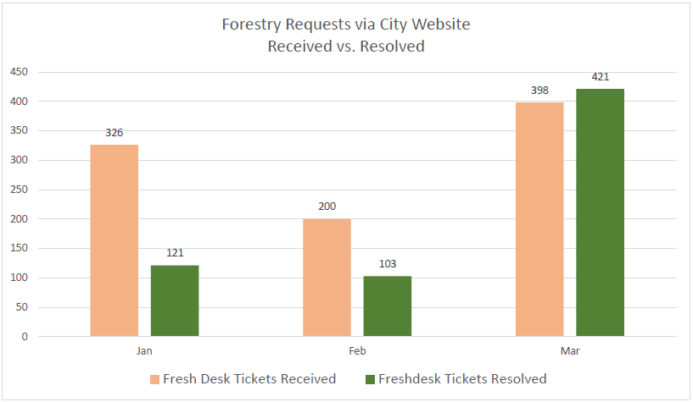
State of Forestry
FreshDesk (digital platform to manage voicemails & emails)
398 emails and voicemails rec’d in March (via Freshdesk)
487 live calls
1,414 communications
300+ requests TBD
*Send emails to: forester@cbts.us
16
Notes:
1,414 calls emails and messages between four staff members.
- 2 people:885 calls, messages, emails with Forestry matters, between two people. We have a little over 300 people to reply back to. We have answered over 900

Slide 18
Conclusion
City will provide:
Updated storm data to inform our methods (per Slide 6)
Monthly updates of the Urban Forest Master Plan
Seeking feedback from Residents and Commissioners:
What would you like to know?
What guidance would you recommend?
Will report back in follow-up F&B presentation
16
Notes:
Recommendations: Constraints of limited City Staff

